Slide 1
Flask 페이지 설계
지우연

Slide 2
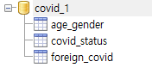
DataBase 설계(테이블)
age_gender: 연령별, 성별 코로나 현황
covid_status: 광역시도별 코로나 현황
foreign_covid: 코로나 해외 현황

Slide 3
DataBase 설계(age_gender)
date | text | not null | 집계 날짜
target | text | not null | 연령/성
confCase | int |  | 확진자 수
confRate | float |  | 확진자 비중(%)
criRate | float |  | 치명률(%)
death | int |  | 사망자 수
deathrate | float |  | 사망자 비중(%)

Slide 4
DataBase 설계(covid_status)
date | text | not null | 집계 날짜
region | text | not null | 광역시도
def_cnts | int |  | 확진자 수
local_occ | int |  | 국내발생 수
over_flow | int |  | 해외유입 수
inc_decs | int |  | 전일 대비 확진자
death_cnts | int |  | 사망자
isol_clr | int |  | 격리 해제
isol_ing | int |  | 격리 중
qur_rates | float |  | 10만명 당 발생률

Slide 5
DataBase 설계(foreign_covid)
date | text | not null | 집계 날짜
continent | text | not null | 지역(대륙)
nation | text | not null | 국가
natDef | int |  | 확진자 수
natDeath | int |  | 사망자 수
natDeathRate | float |  | 확진률 대비 사망률

Slide 6
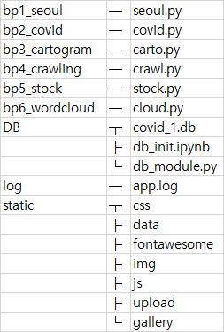
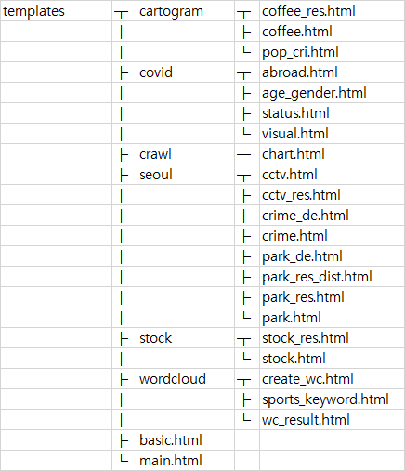
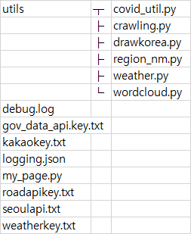
파일 구조 – 데이터 분석

Slide 7
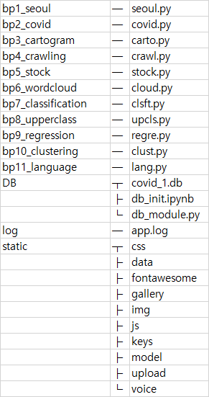
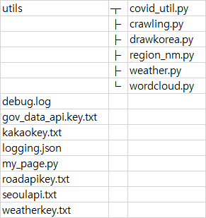
파일 구조 – 머신러닝

Slide 8
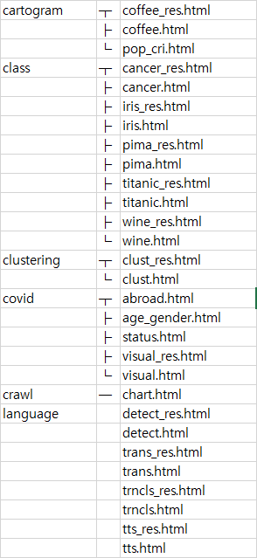
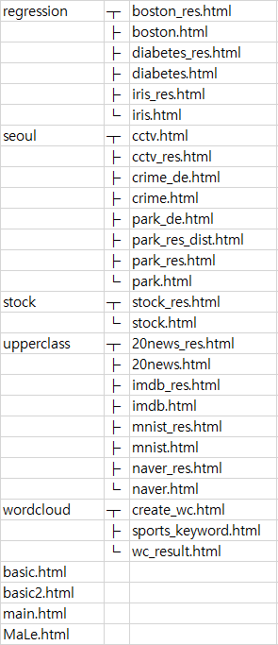
파일 구조 – 머신러닝(templates)

Slide 9
Routing - 메인
path | detail path | method | client -> server parameter | html파일 | server -> html params | 다음 행선지
/ |  | get |  |  |  | /main, /MaLe
/main |  | get |  | main.html | menu, weather | /seoul, /covid, /crawl, /stock, /carto, /cloud
/MaLe |  | get |  | MaLe.html | menu, weather | /class, /upcls, /regre, /clust,

Slide 10
Routing - /seoul
path | detail path | method | client -> server parameter | html파일 | server -> html params | 다음 행선지
/seoul |  |  |  |  |  | /seoul/park /seoul/park_de/area /seoul/crime /seoul/cctv
/seoul/park |  | get |  | park.html | menu, weather, park_list, dist_list, mtime | park_res.html park_res_dist.html
 |  | post | distinct, name/dist | park_res.html park_res_dist.html | menu, weather, park_result/ dist_result, mtime
/seoul/park_de | /area | get | option | park_de.html | menu, weather, option, option_dict, mtime
 | /count
 | /area_ratio
 | /per_person

Slide 11
Routing - /seoul
path | detail path | method | client -> server parameter | html파일 | server -> html params | 다음 행선지
/seoul/crime |  |  |  |  |  | /crime_de/violence, /crime_de/rape, /crime_de/theft, /crime_de/robbery, /crime_de/murder, /crime_de/violence_arr, /crime_de/rape_arr, /crime_de/theft_arr, /crime_de/robbery_arr, /crime_de/murder_arr
/seoul/crime_de | /violence | get | option | crime_de.html | menu, weather, option, option_dict1, option_dict2, column_index, mtime
 | /rape
 | /theft
 | /robbery
 | /murder
 | /violence_arr | post
 | /rape_arr
 | /theft_arr
 | /robbery_arr
 | /murder_arr

Slide 12
Routing - /seoul
path | detail path | method | client -> server parameter | html파일 | server -> html params | 다음 행선지
/seoul/cctv |  | get |  | cctv.html |  | cctv_res.html
 |  | post | kind | cctv_res.html | kind, menu, weather, mtime

Slide 13
Routing - /covid
path | detail path | method | client -> server parameter | html파일 | server -> html params | 다음 행선지
/covid |  |  |  |  |  | /covid/national_status, /covid/age_gender, /covid/abroad, /covid/visual
/covid/national_status |  | get |  | status.html | menu, weather, rows, date | /covid/update_status
/covid/update_status | <date> | get | date
/covid/age_gender |  | get |  | age_gender.html | menu, weather, rows, date | /covid/update_age_gender
/covid/update_age_gender | <date> | get | date
/covid/abroad |  | get |  | abroad.html | menu, weather, rows, date | /covid/update_abroad
/covid/update_abroad | <date> | get | date
/covid/visual |  | get |  | visual.html | menu, weather, mtime, regions | visual_res.html
 |  | post | district | visual_res.html | menu, weather, mtime

Slide 14
Routing - /carto
path | detail path | method | client -> server parameter | html파일 | server -> html params | 다음 행선지
/carto |  |  |  |  |  | /carto/pop_crisis, /carto/coffee
/carto/pop_crisis | /crisis_area | get | option | pop_cri.html | menu, weather, mtime, option, columns
 | /crisis_ratio
/carto/coffee |  | get |  | coffee.html | menu, weather | coffee_res.html
/covid/update_age_g | <date> | post | carto_list, csv | coffee_res.html | menu, weather, carto, mtime, top10

Slide 15
Routing - /crawl
path | detail path | method | client -> server parameter | html파일 | server -> html params | 다음 행선지
/crawl |  |  |  |  |  | /crawl/chart
/crawl/chart |  | get |  | chart.html | menu, weather, bugs, melon, genie

Slide 16
Routing - /cloud
path | detail path | method | client -> server parameter | html파일 | server -> html params | 다음 행선지
/cloud |  |  |  |  |  | /cloud/create_wc, /cloud/sports_keyword
/cloud/create_wc |  | get |  | create_wc.html | menu, weather | wc_result.html
 | /crisis_ratio | post | lang, txt, mask, stopwords | wc_result.html | menu, weather, mtime
/cloud/sports_keyword |  | get |  | sports_keyword.html | menu, weather, mtime

Slide 17
Routing - /class
path | detail path | method | client -> server parameter | html파일 | server -> html params | 다음 행선지
/class |  |  |  |  |  | /class/cancer
/class/cancer |  | get |  | cancer.html | menu, weather | cancer_res.html
/covid/update_age_g | <date> | post | index | cancer_res.html | menu, weather, result
/class/pima |  | get |  | pima.html | menu, weather | pima_res.html
 |  | post | index | pima_res.html | menu, weather, dict
/class/titanic |  | get |  | titanic.html | menu, weather | titanic_res.html
 |  | post | index | titanic_res.html | menu, weather, dict
/class/iris |  | get |  | iris.html | menu, weather | iris_res.html
 |  | post | index | iris_res.html | menu, weather, dict
/class/wine |  | get |  | wine.html | menu, weather | wine_res.html
 |  | post | index | wine_res.html | menu, weather, dict

Slide 18
Routing - /upcls
path | detail path | method | client -> server parameter | html파일 | server -> html params | 다음 행선지
/upcls |  |  |  |  |  | /upcls/mnist
/upcls/mnist |  | get |  | mnist.html | menu, weather | mnist_res.html
/covid/update_age_g | <date> | post | index | mnist_res.html | menu, weather, dict, mtime
/upcls/20news |  | get |  | 20news.html | menu, weather | 20news_res.html
 |  | post | index | 20news_res.html | menu, weather, result
/upcls/IMDB |  | get |  | imdb.html | menu, weather | imdb_res.html
 |  | post | select, review, index | imdb_res.html | menu, weather, p_c, p_t, review
/upcls/NaverMovie |  | get |  | naver.html | menu, weather | naver_res.html
 |  | post | select, review, index | naver_res.html | menu, weather, result

Slide 19
Routing - /regre
path | detail path | method | client -> server parameter | html파일 | server -> html params | 다음 행선지
/regre |  |  |  |  |  | /regre/iris
/regre/iris |  | get |  | iris.html | menu, weather | iris_res.html
/covid/update_age_g | <date> | post | index, feature | iris_res.html | menu, weather, pred, index, X, feature, ft_name
/regre/diabetes |  | get |  | diabetes.html | menu, weather, list | diabete_res.html
 |  | post | index, feature | diabetes_res.html | menu, weather, pred, index, feature, list, label, mtime
/regre/boston |  | get |  | boston.html | menu, weather, columns | boston_res.html
 |  | post | index, feature | boston_res.html | menu, weather, dict

Slide 20
Routing - /clust
path | detail path | method | client -> server parameter | html파일 | server -> html params | 다음 행선지
/clust |  |  |  |  |  | /clust/clust
/clust/clust |  | get |  | clust.html | menu, weather | clust_res.html
/covid/update_age_g | <date> | post | file, n | clust_res.html | menu, weather, mtime, n_cluster

Slide 21
Routing - /lang
path | detail path | method | client -> server parameter | html파일 | server -> html params | 다음 행선지
/lang |  |  |  |  |  | /lang/translate
/lang/translate |  | get |  | trans.html | menu, weather | trans_res.html
/covid/update_age_g | <date> | post | text, lang | trans_res.html | menu, weather, result
/lang/tts |  | get |  | tts.html | menu, weather | tts_res.html
 |  | post | text, speaker, speed, pitch, emotion | tts_res.html | menu, weather, info, mtime
/lang/trn_cls |  | get |  | trncls.html | menu, weather | trncls_res.html
 |  | post | text, trans_type | trncls_res.html | menu, weather, result
/lang/detect_lang |  | get |  | detect.html | menu, weather | detect_res.html
 |  | post | text | detect_res.html | menu, weather, result

Slide 22
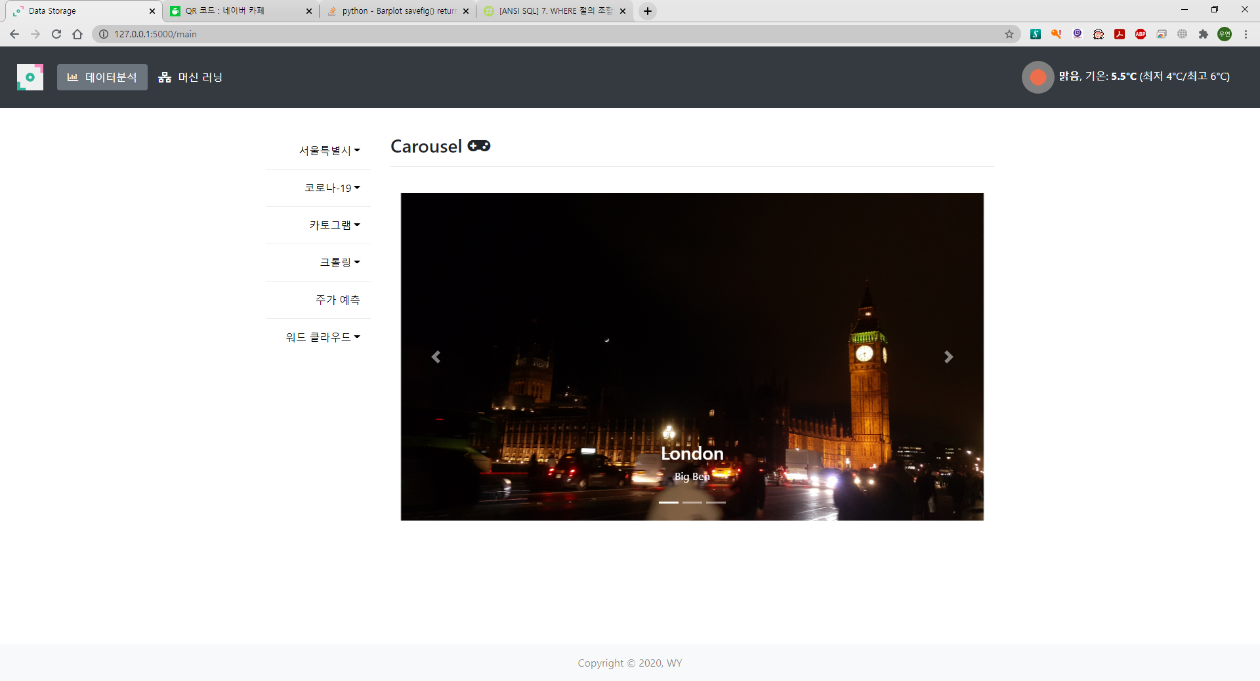
main 화면

Slide 23
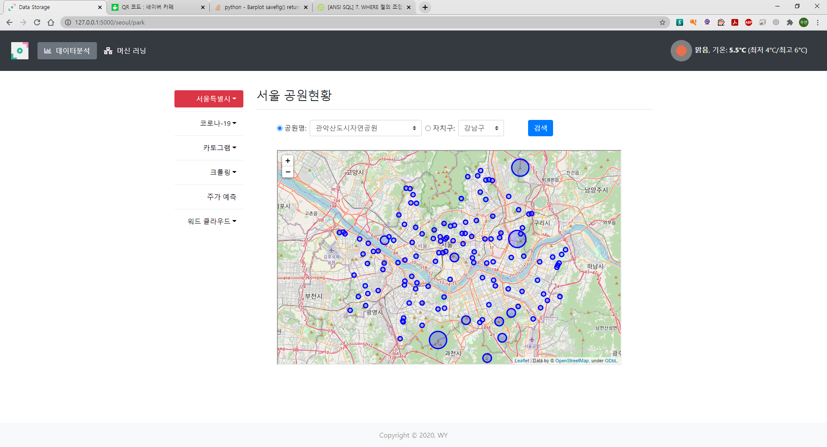

Slide 24
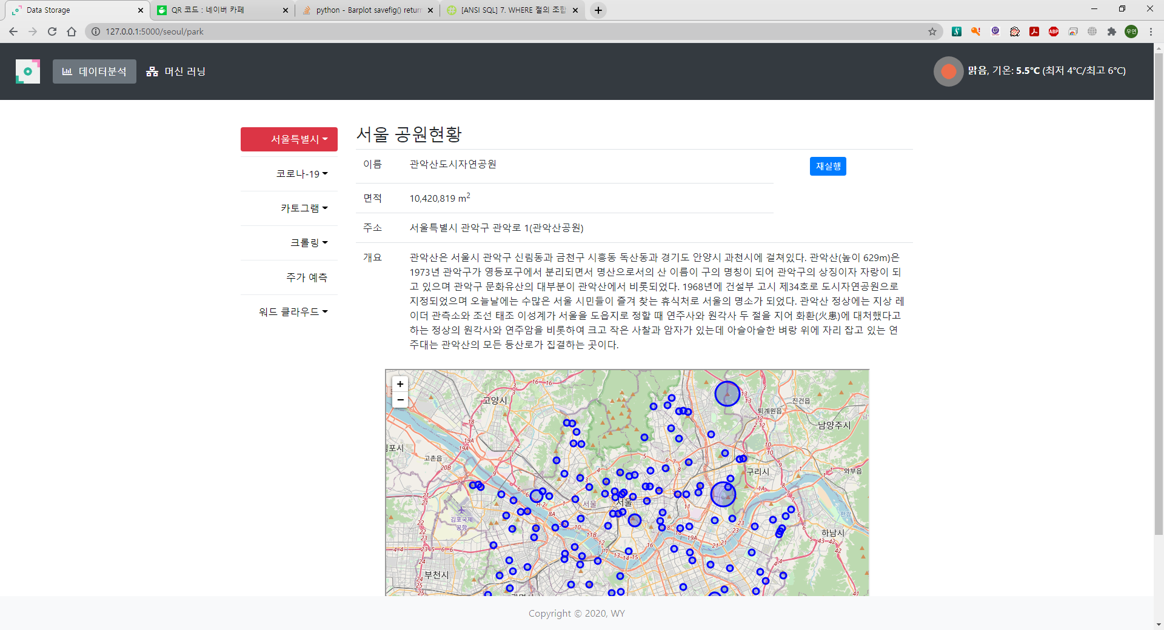
공원 정보 입력 후

Slide 25
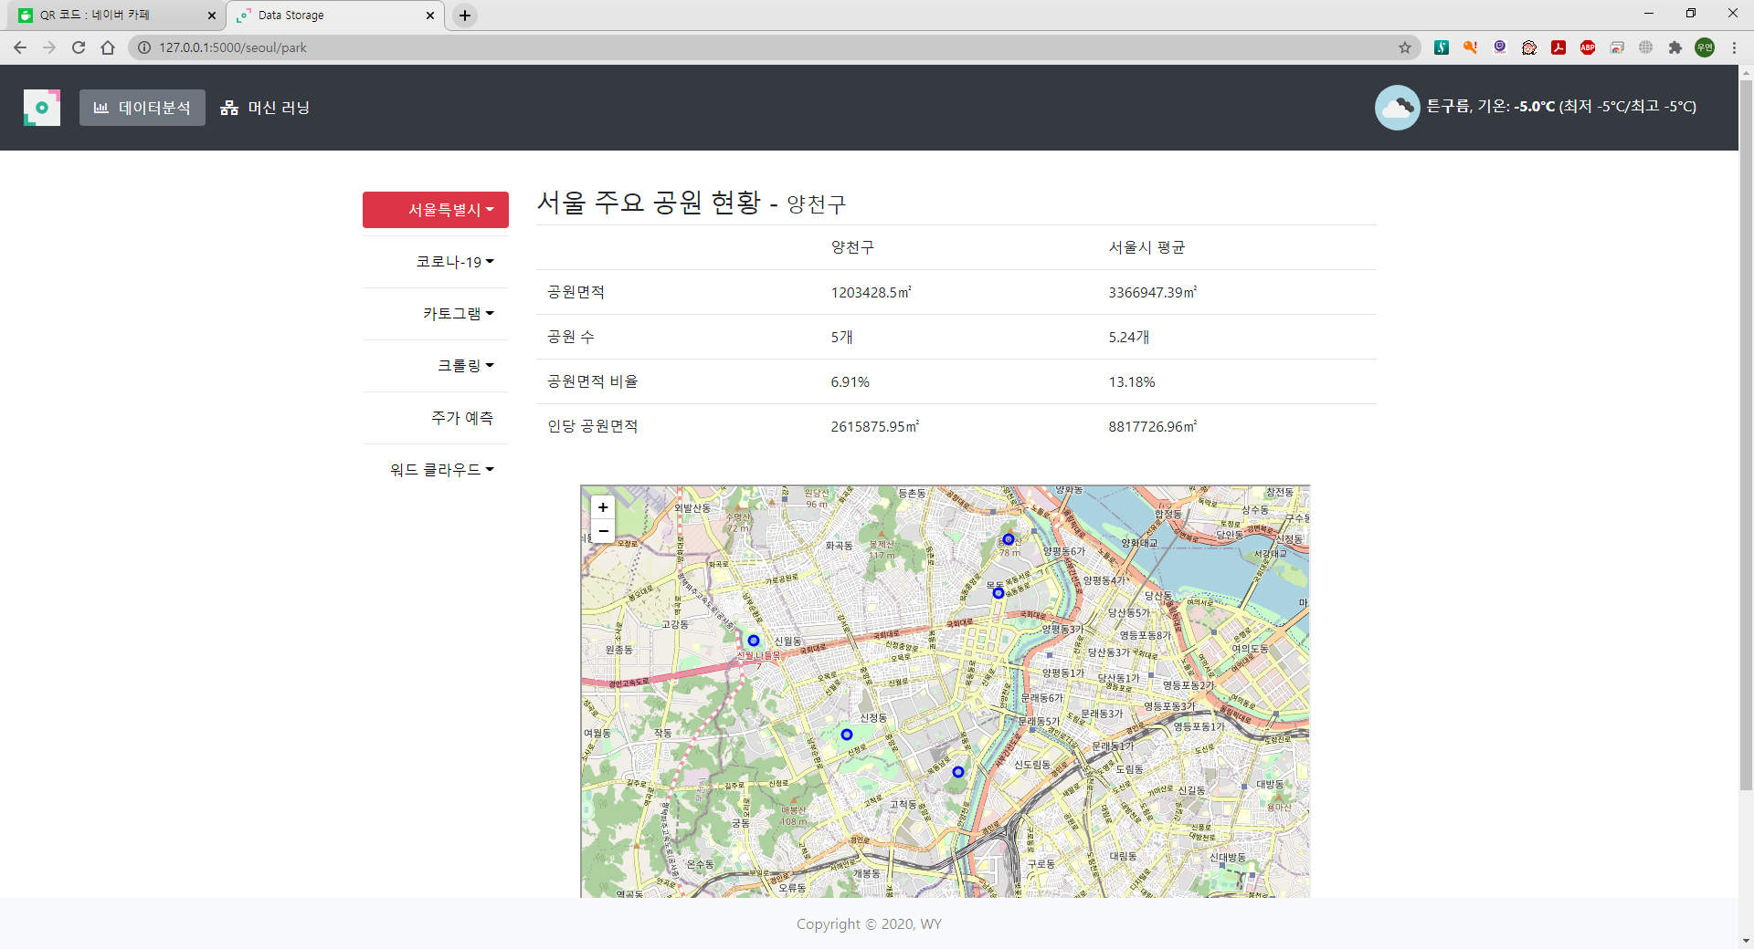
구 정보 입력 후

Slide 26
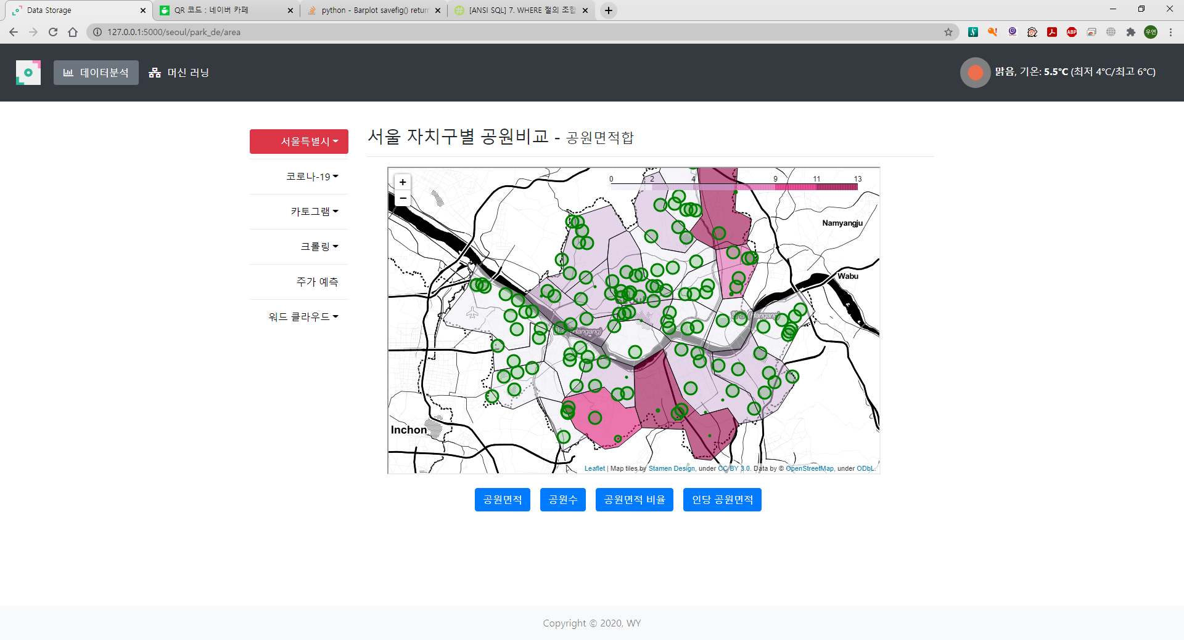

Slide 27
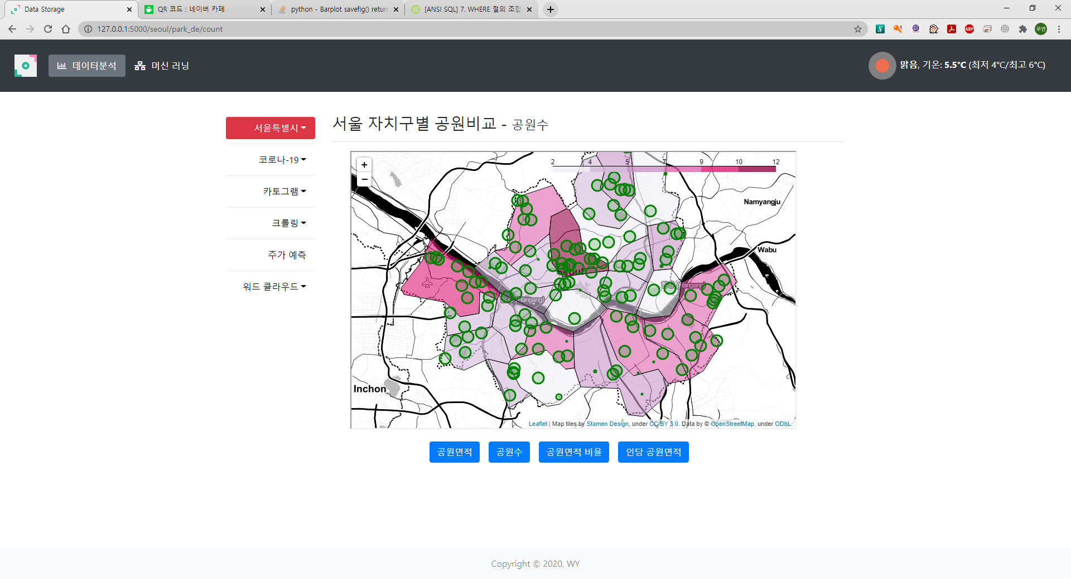

Slide 28
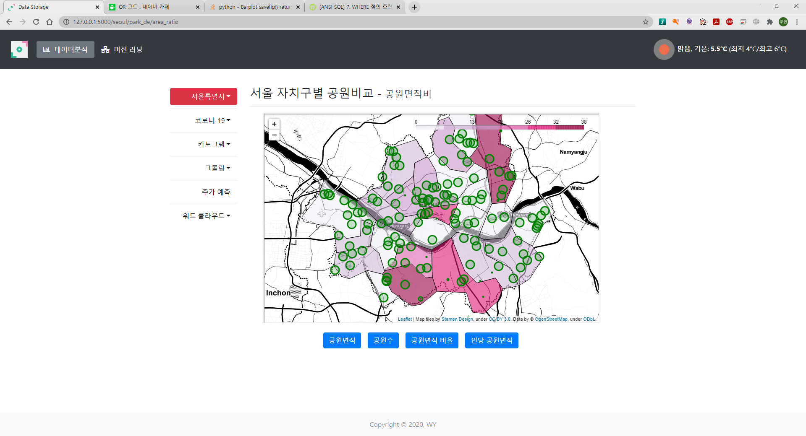

Slide 29
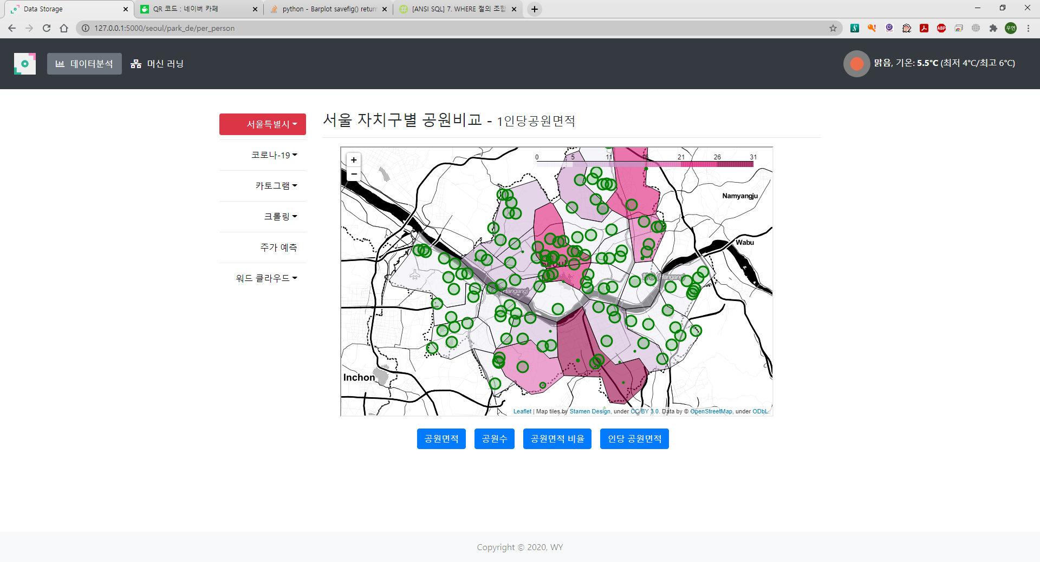

Slide 30
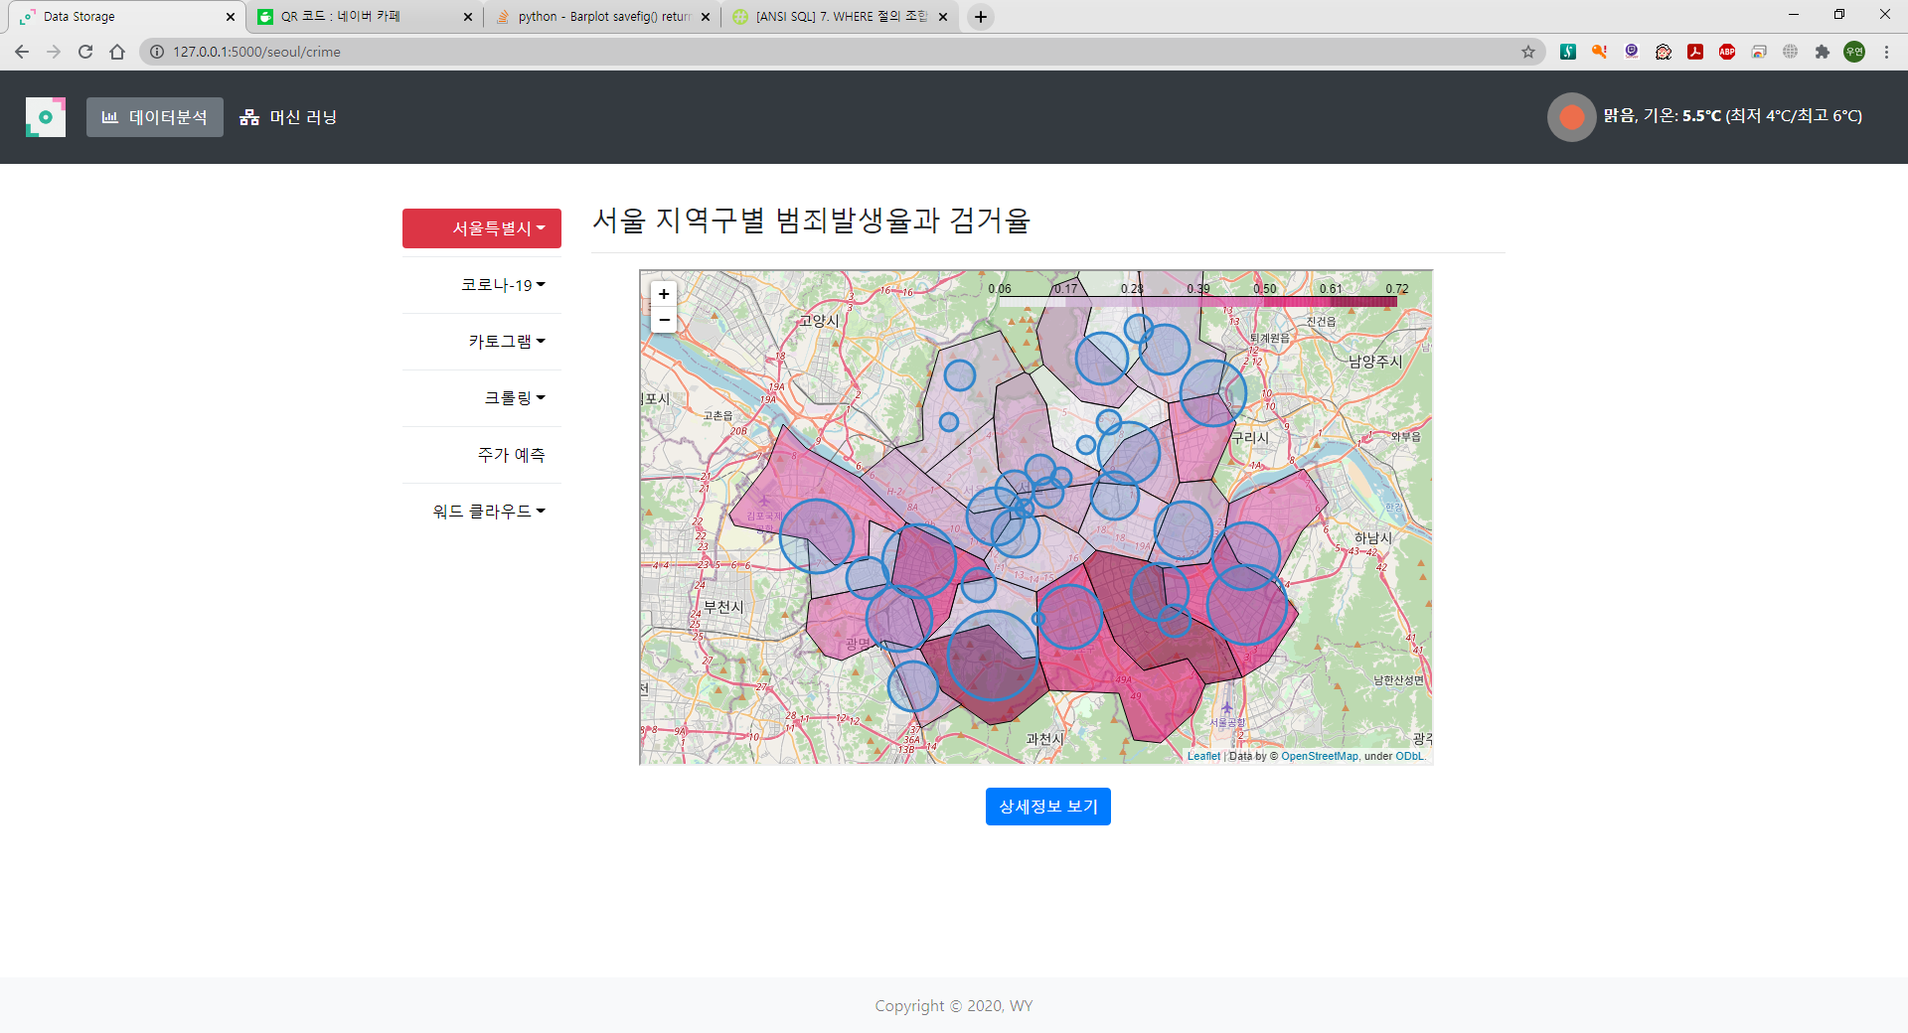

Slide 31
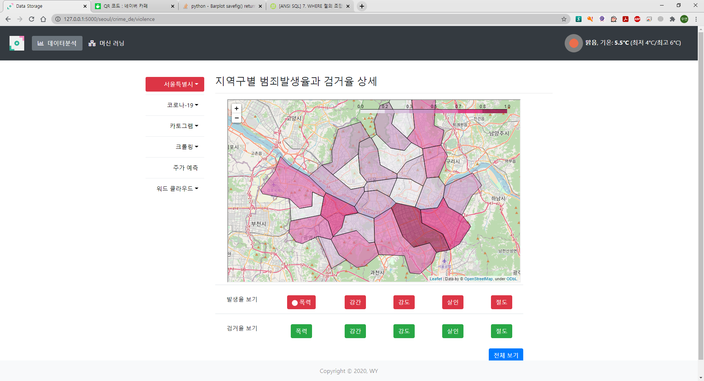
상세 보기 클릭 후
- 발생율

Slide 32
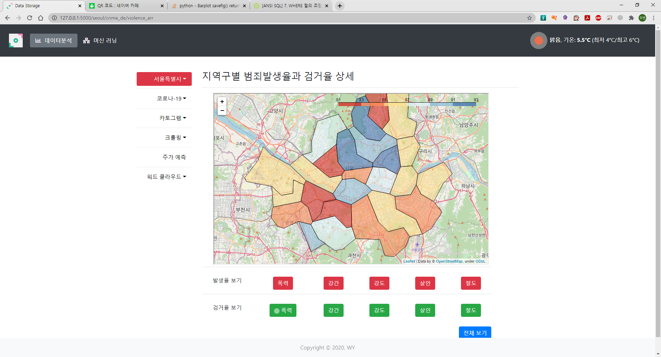
검거율 화면

Slide 33
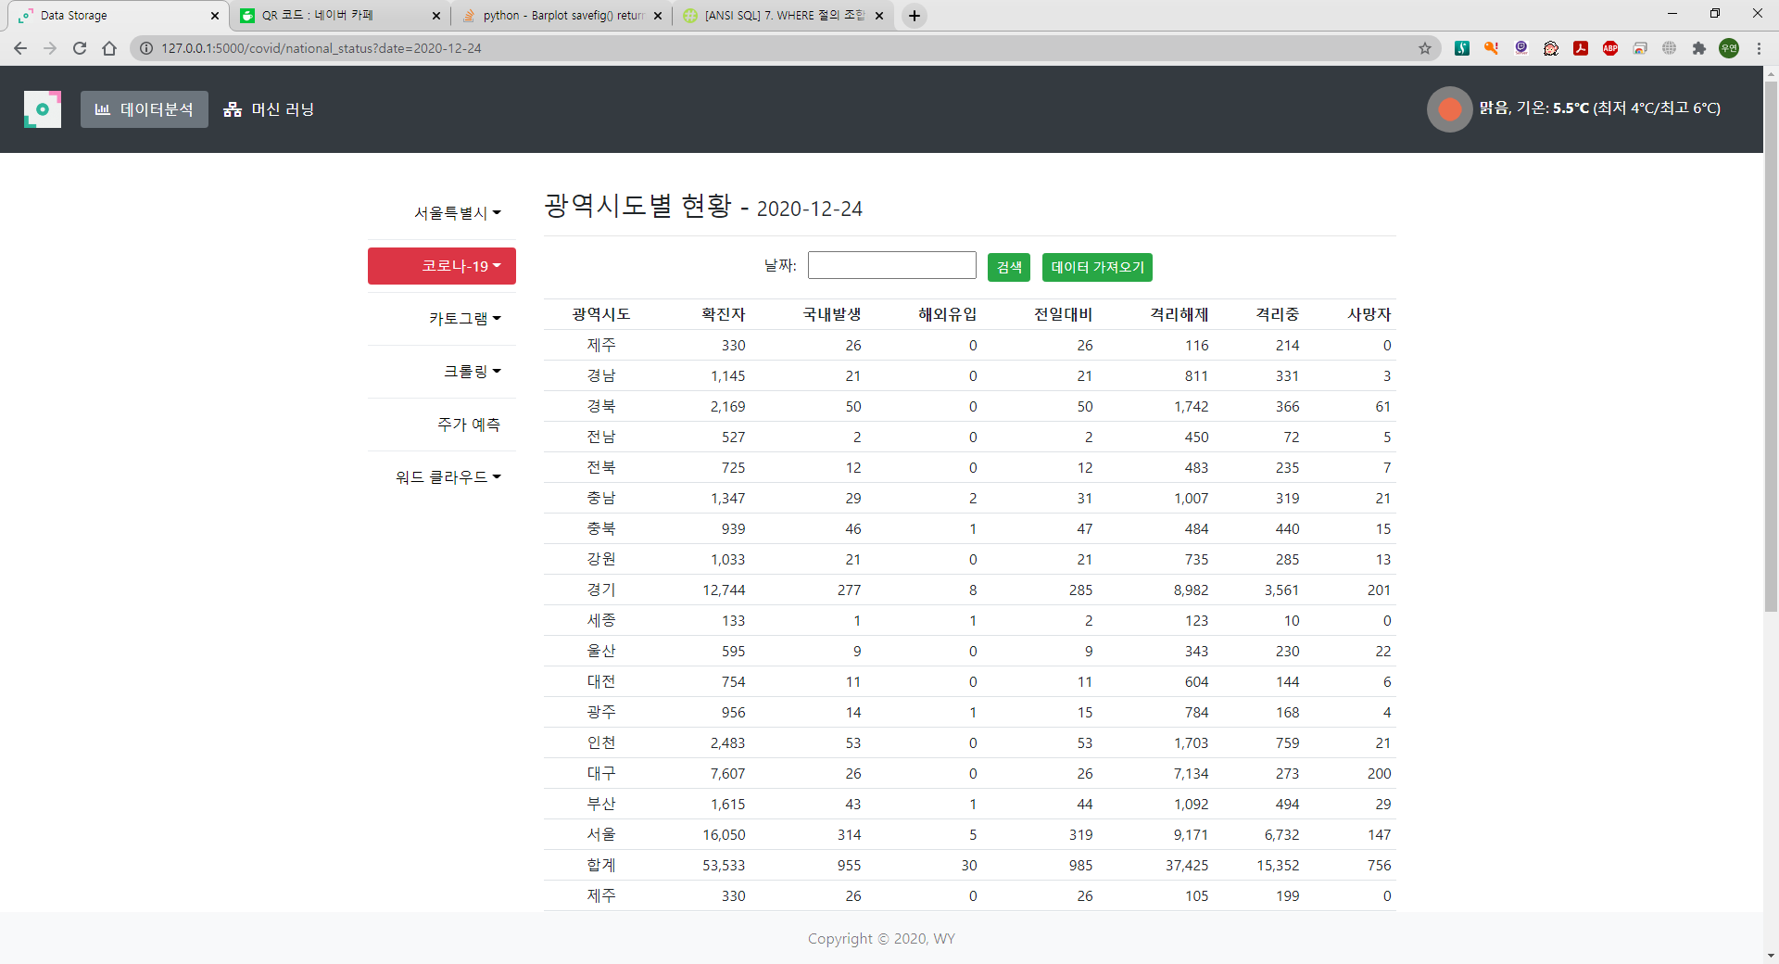

Slide 34
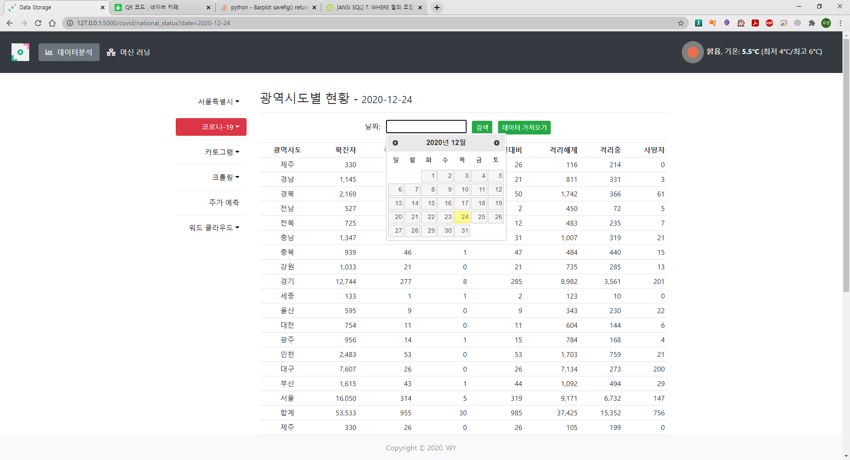
날짜 선택

Slide 35
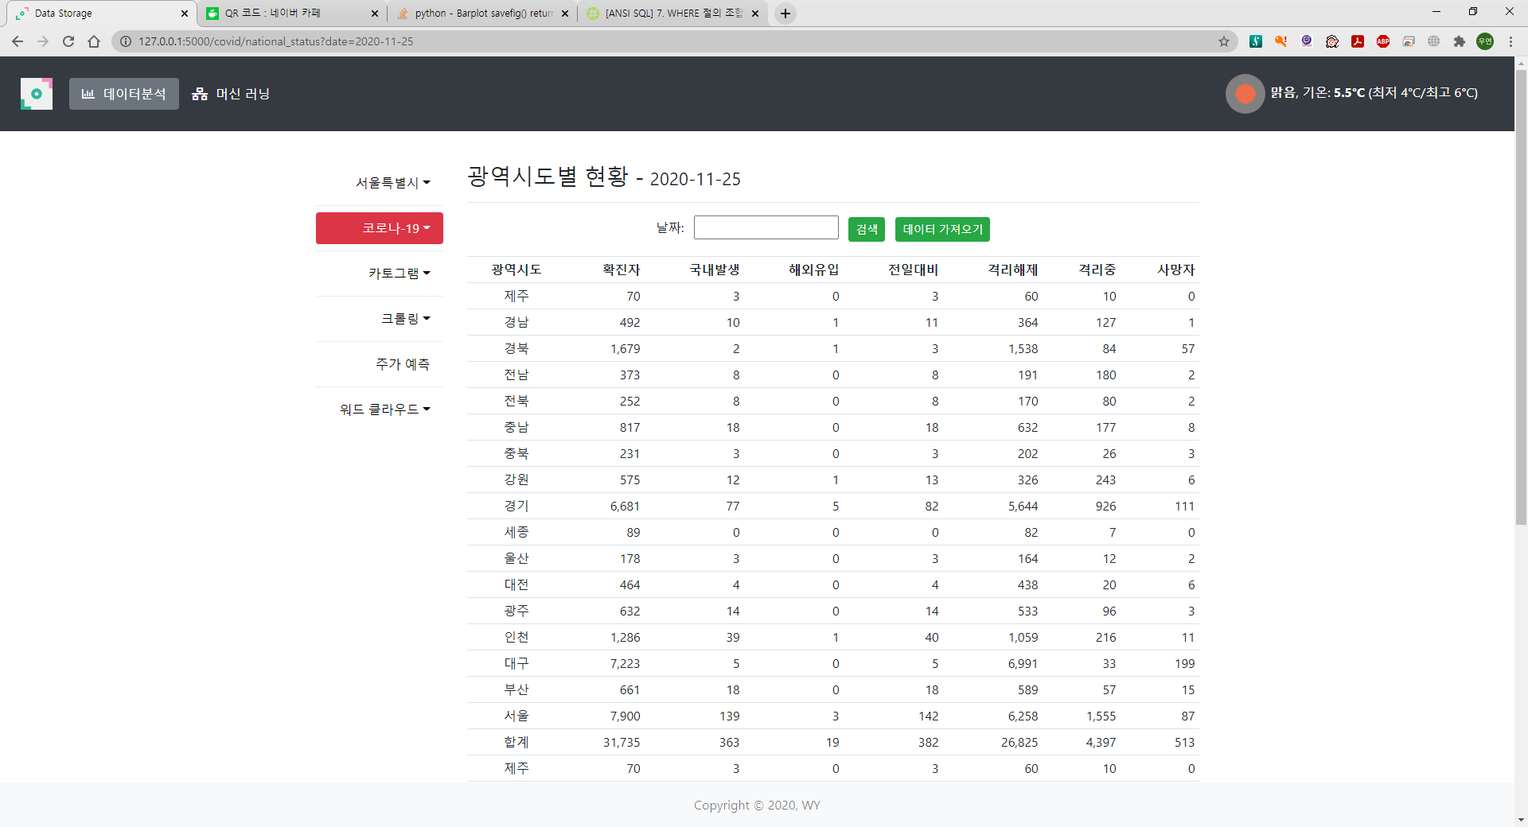

Slide 36
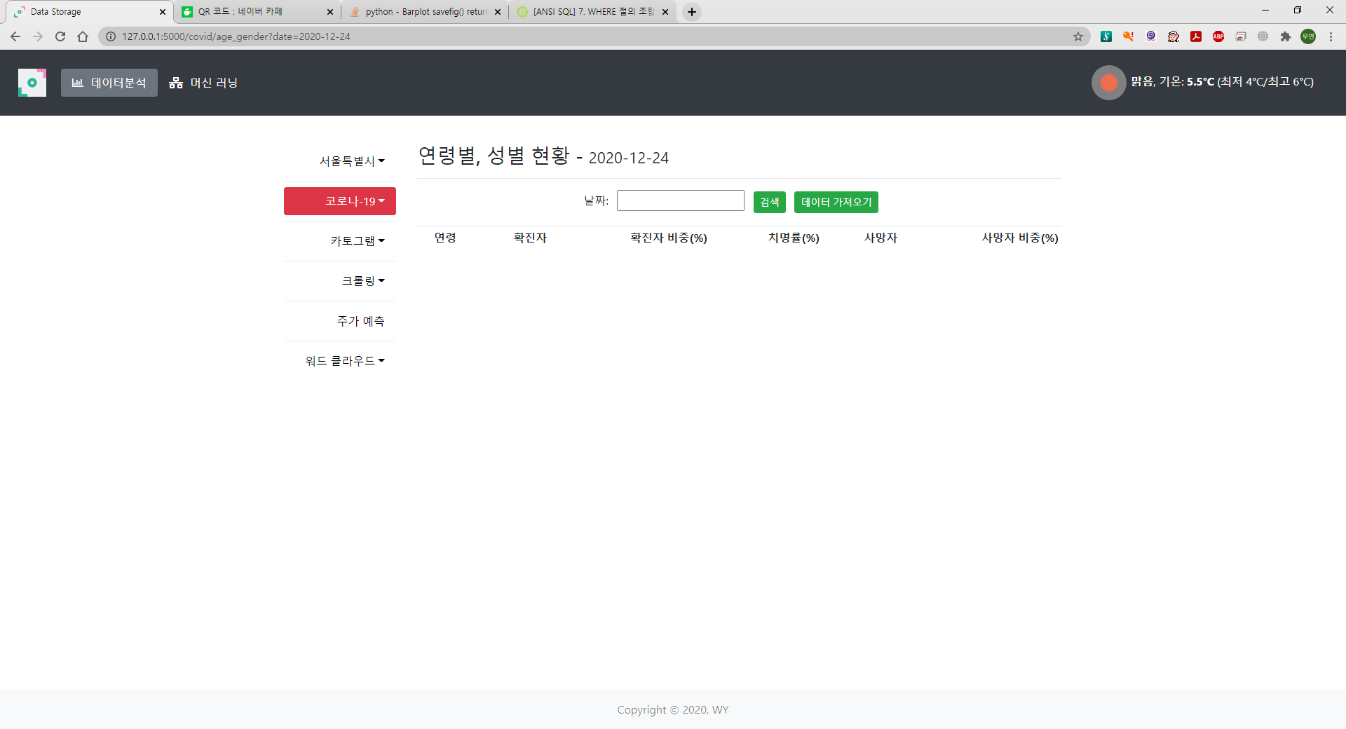

Slide 37
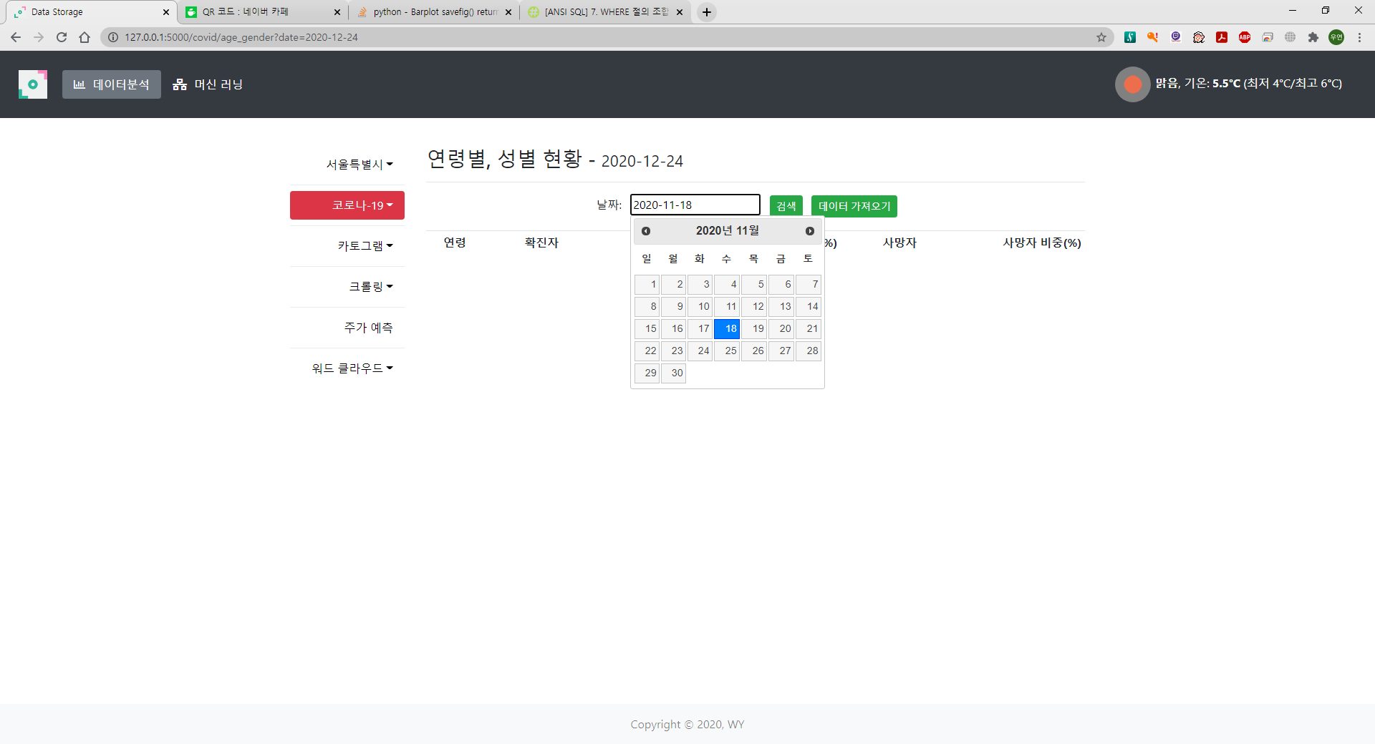
날짜 선택

Slide 38
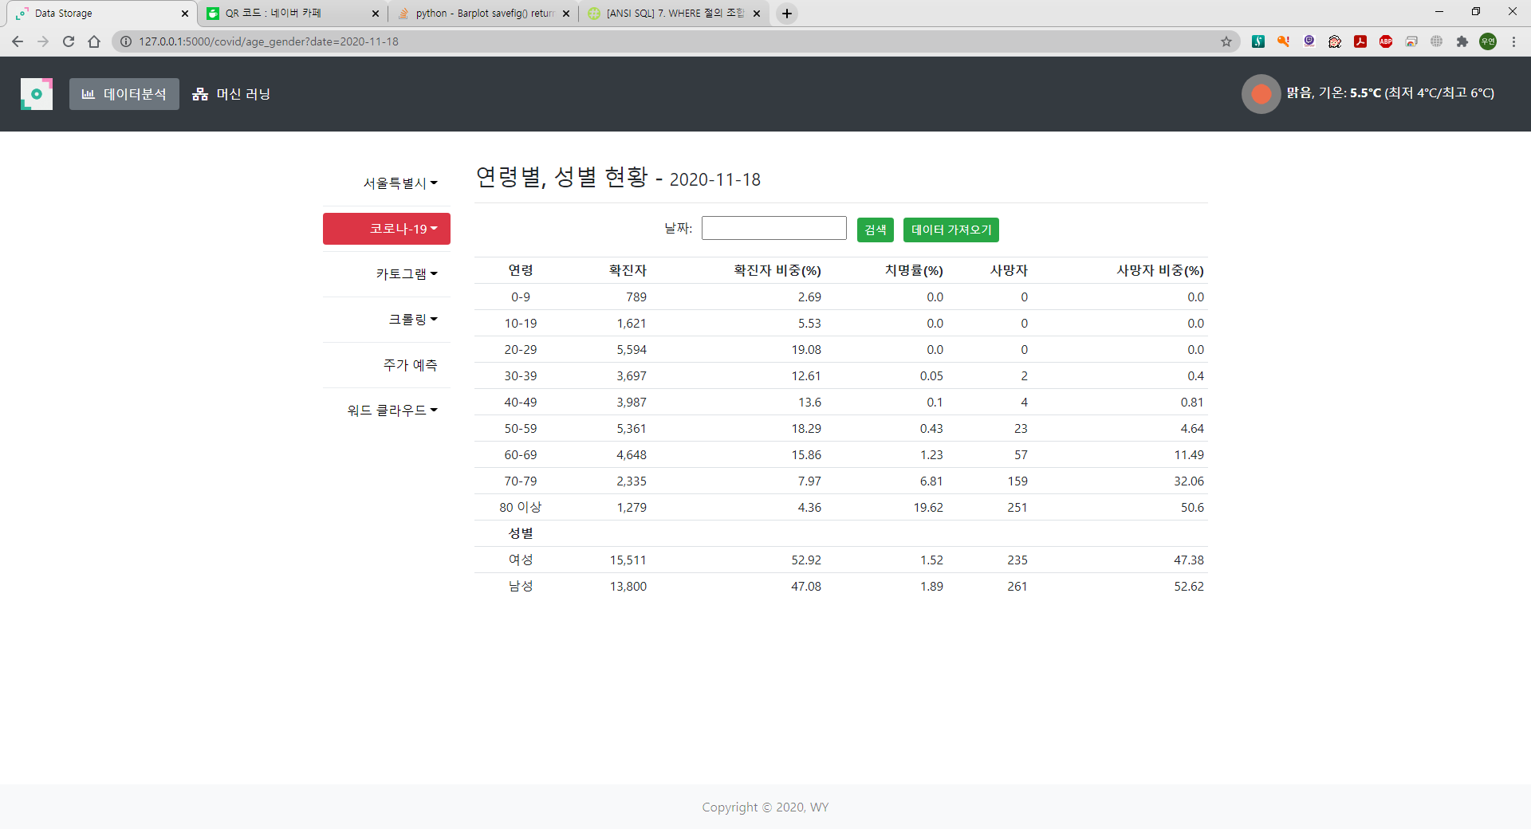

Slide 39
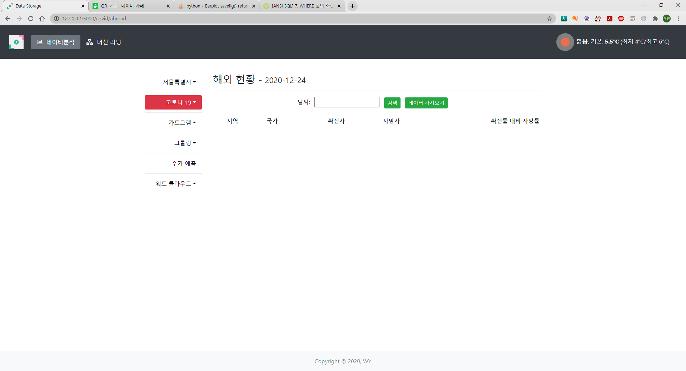

Slide 40
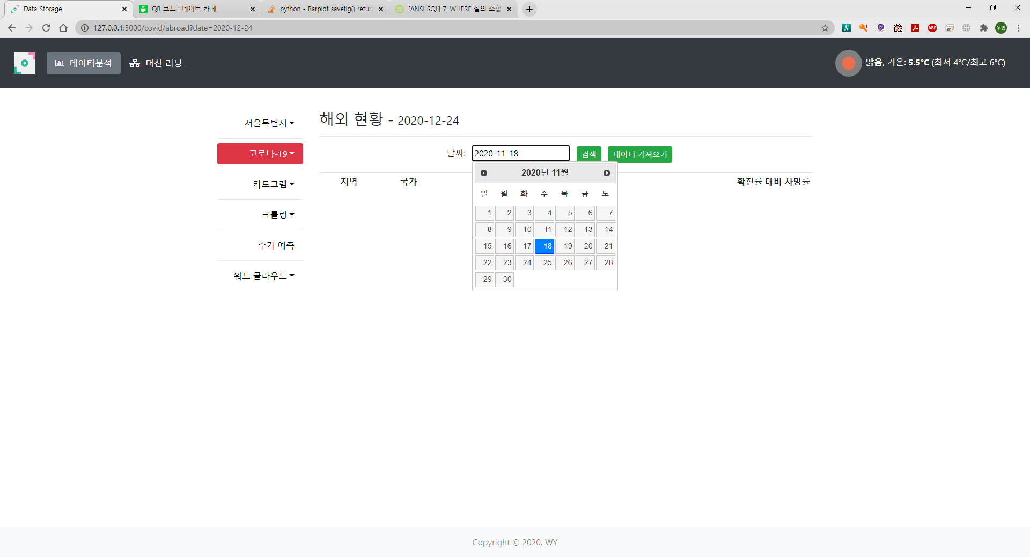
날짜 선택

Slide 41
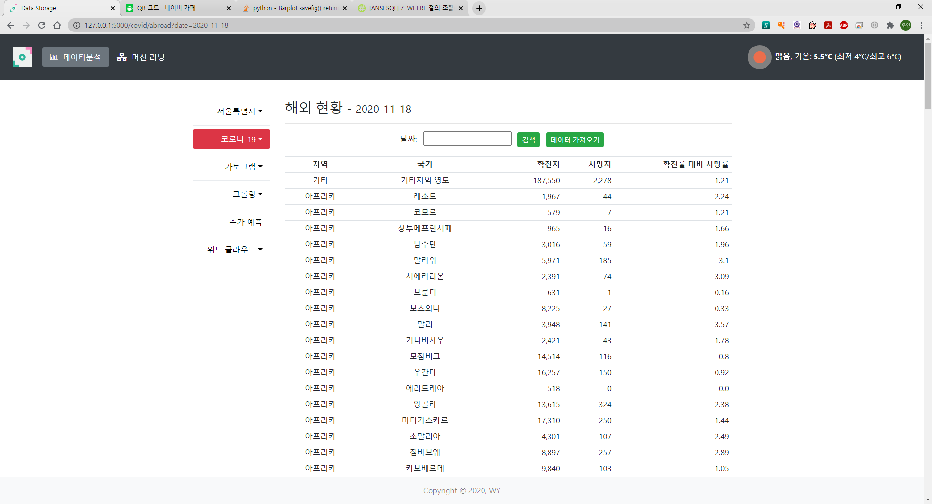

Slide 42
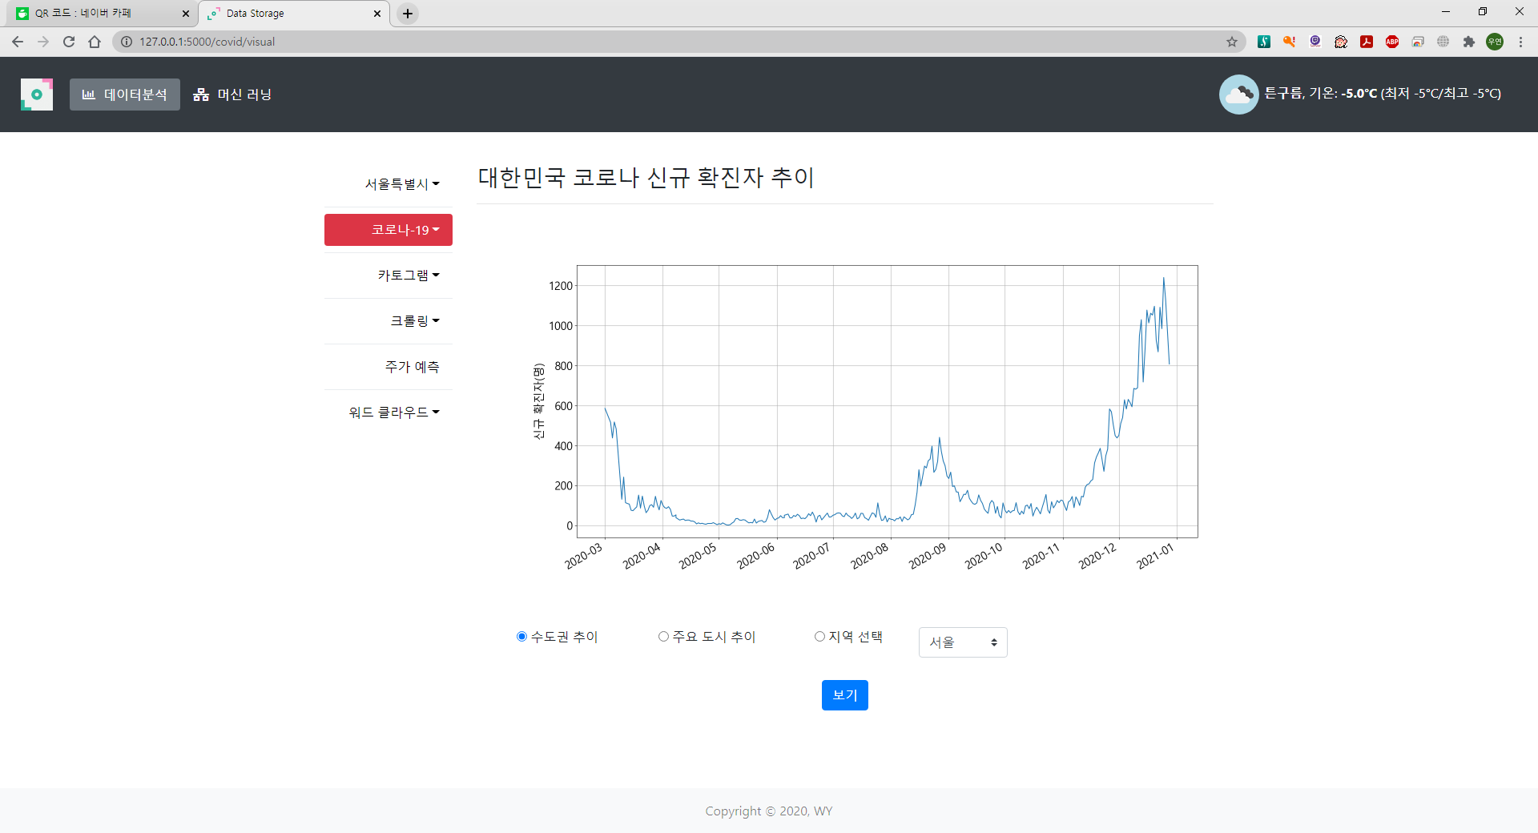

Slide 43
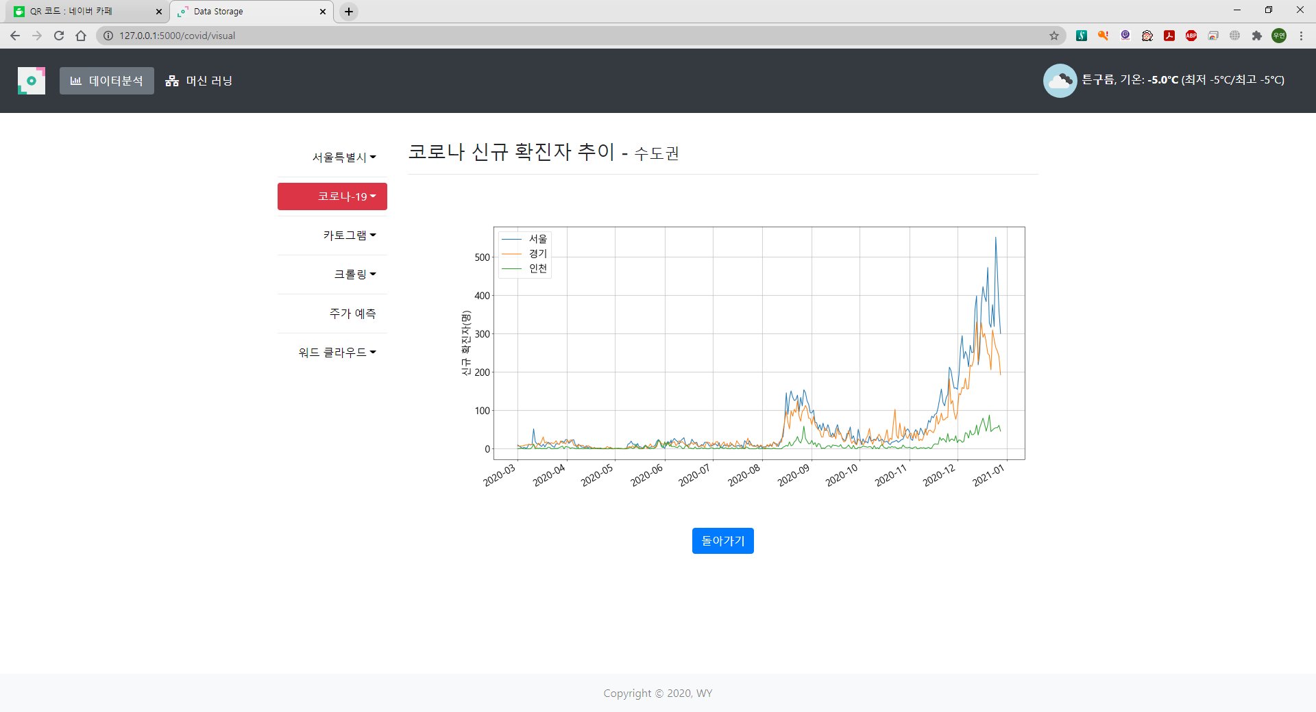
수도권 추이

Slide 44
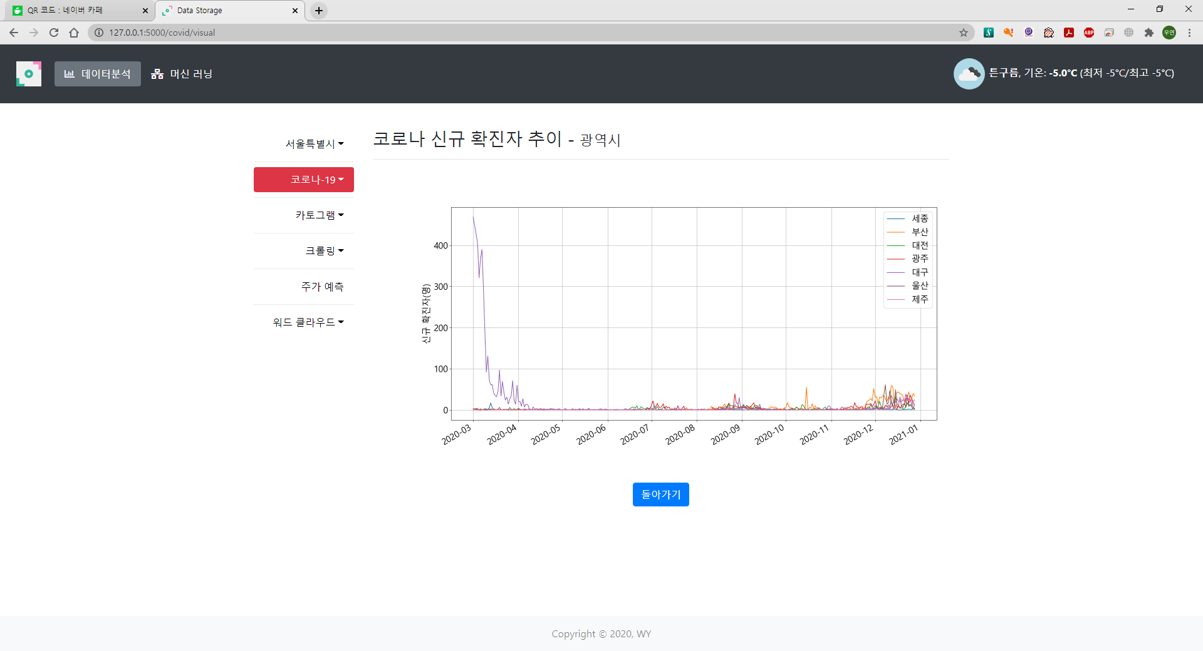
주요 도시 추이

Slide 45
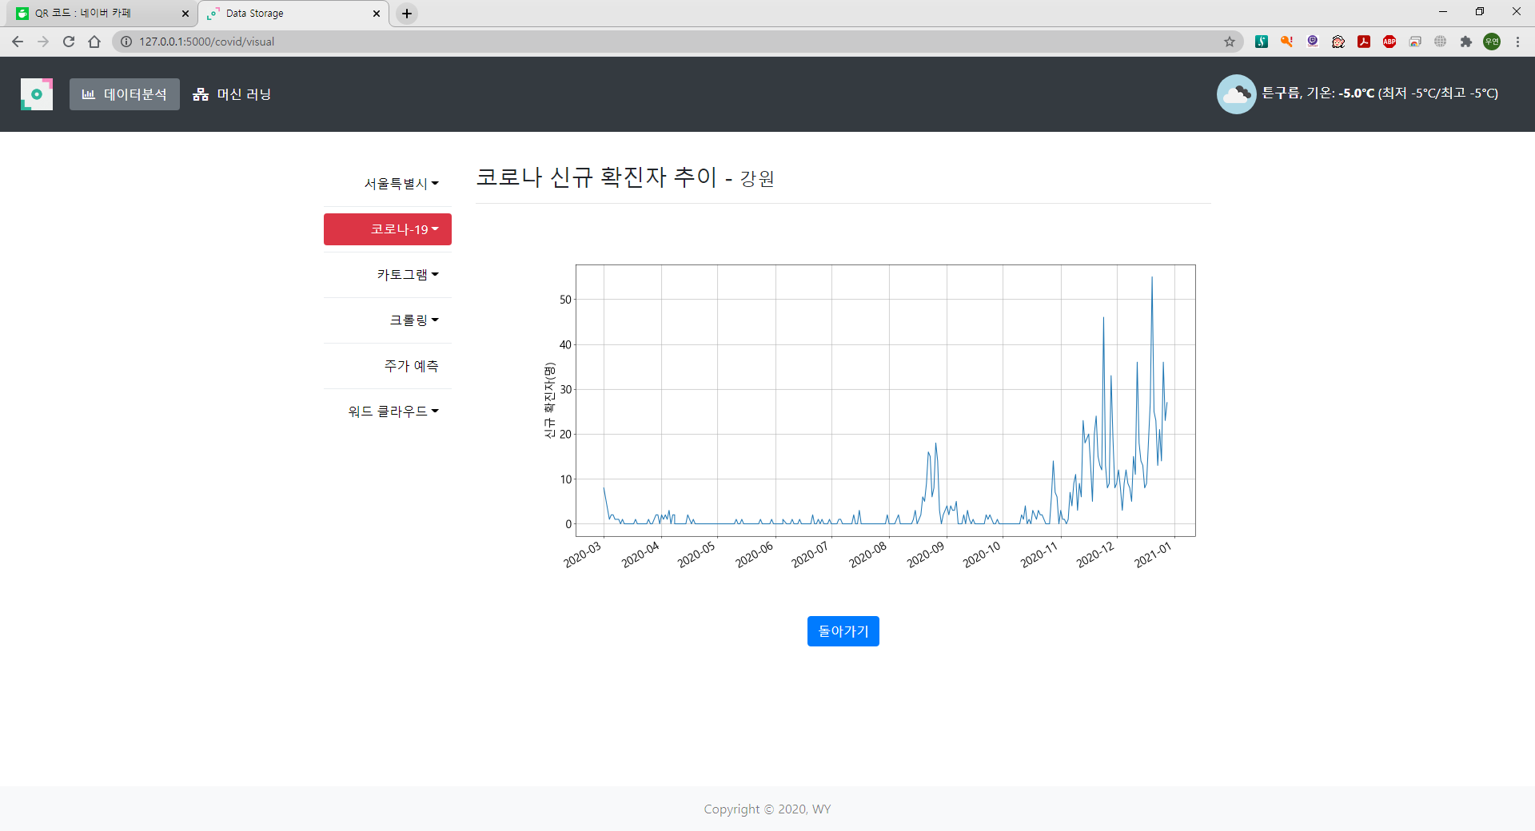
선택한 도시 추이

Slide 46
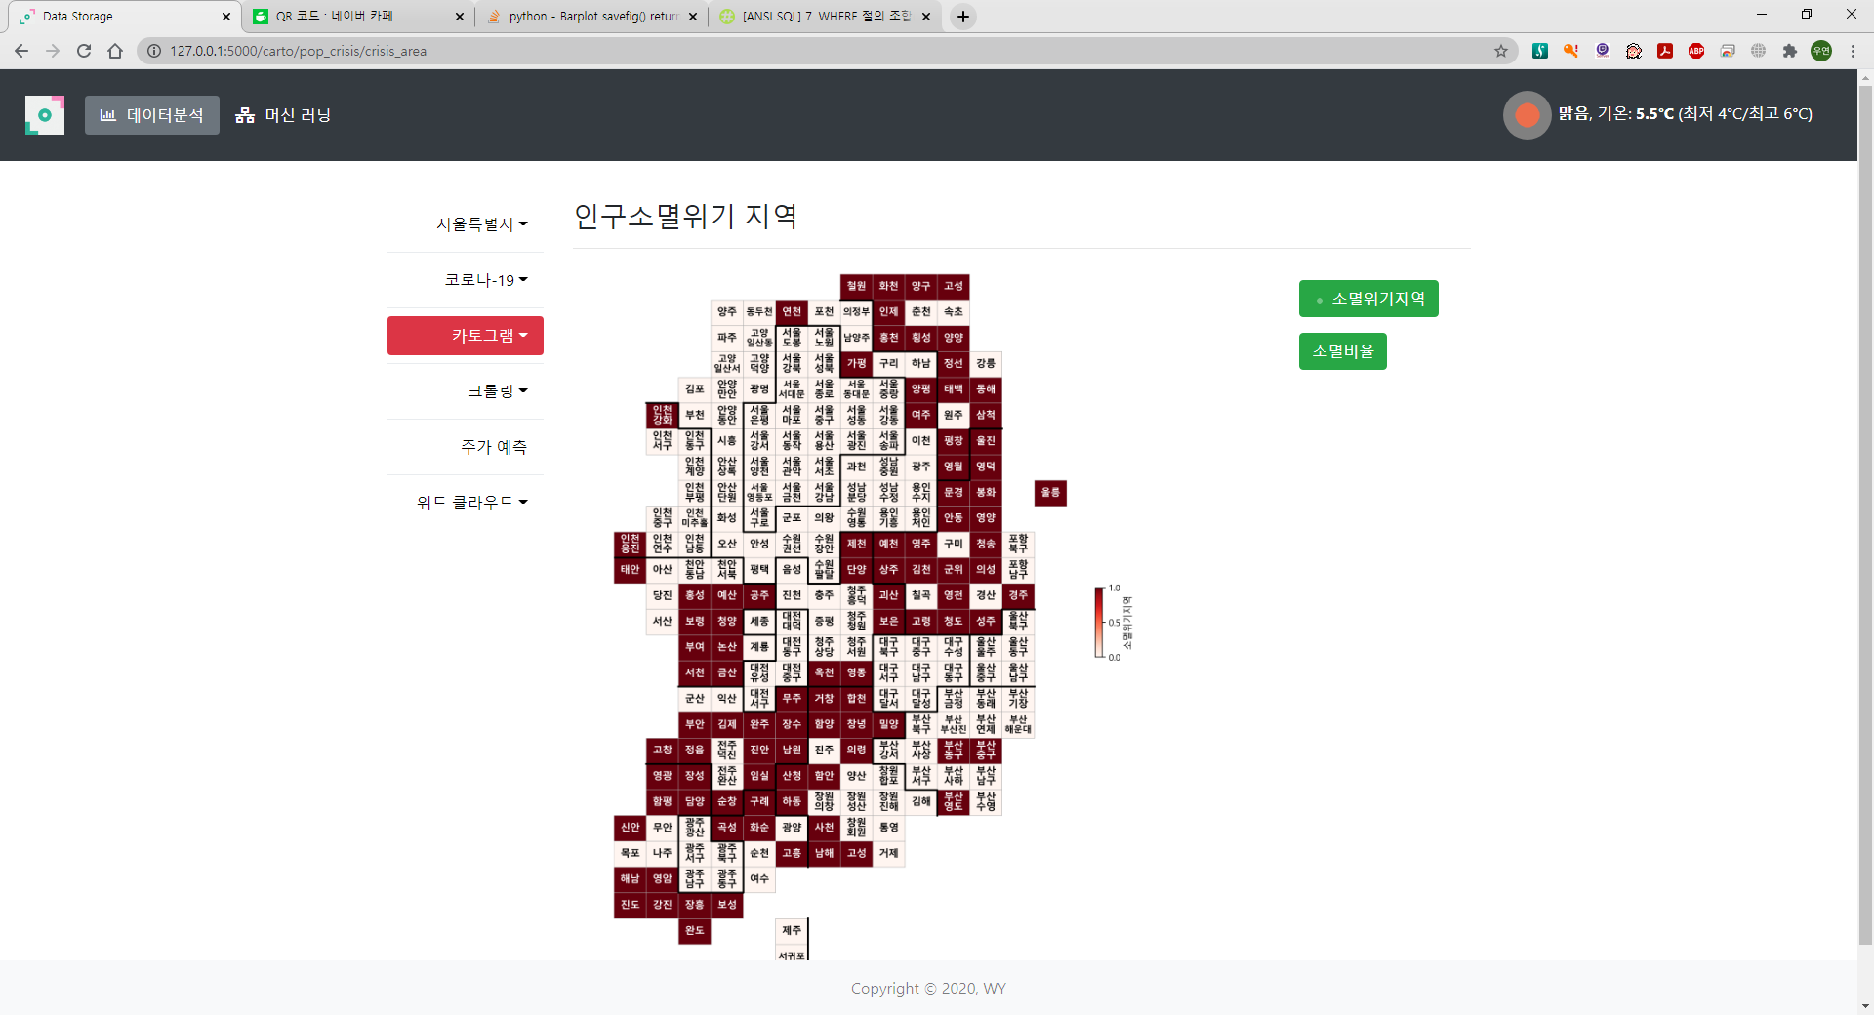

Slide 47
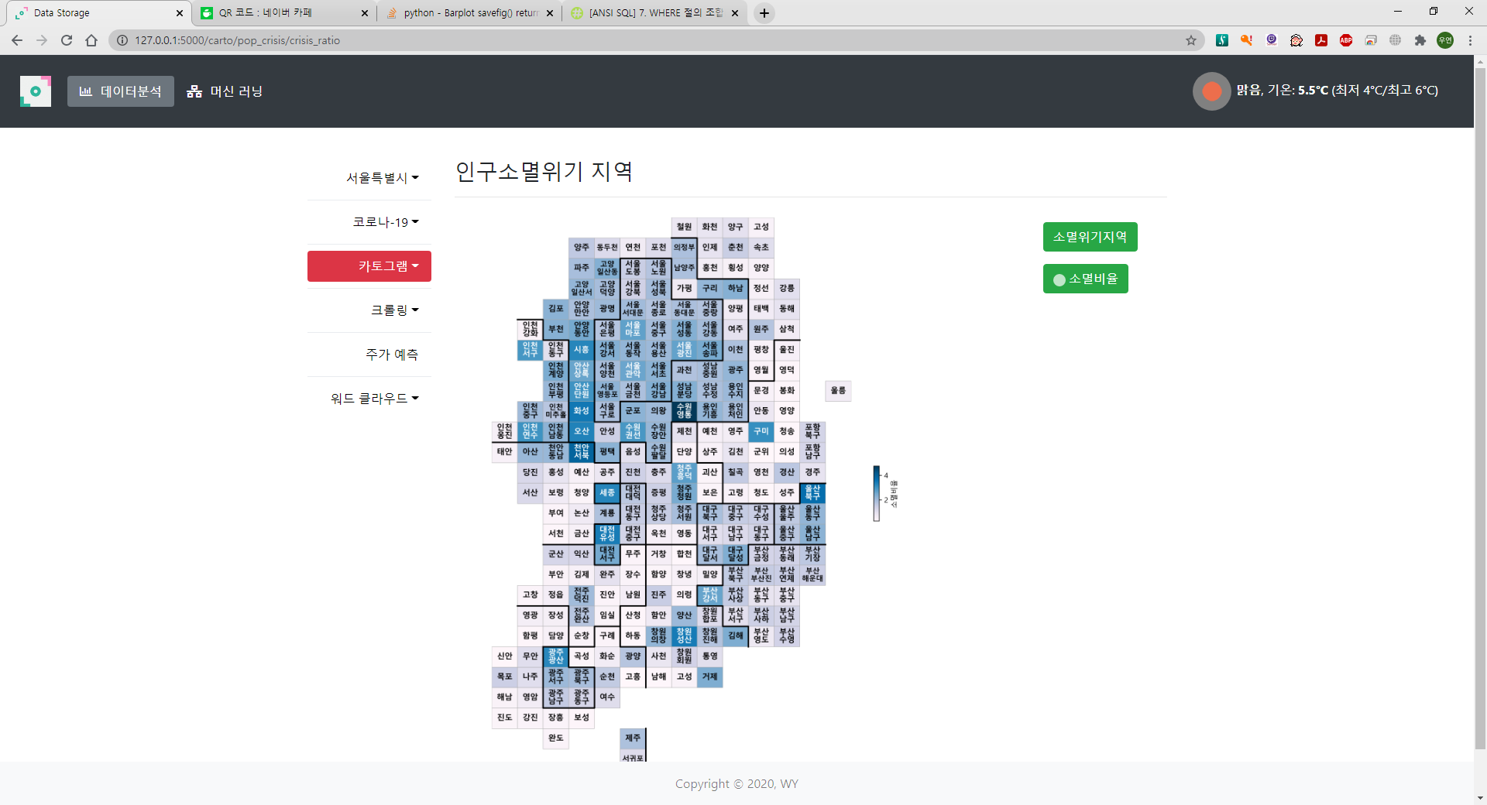

Slide 48
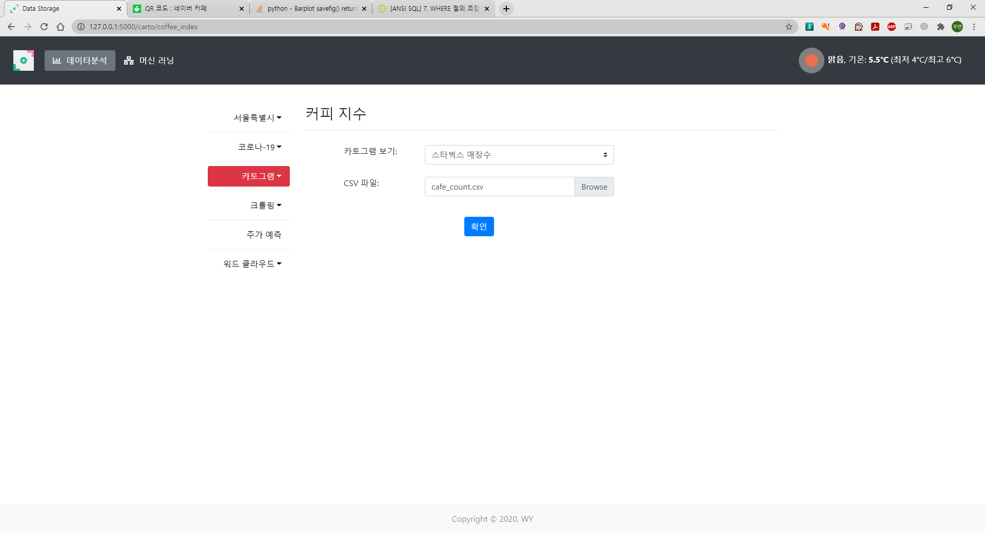

Slide 49
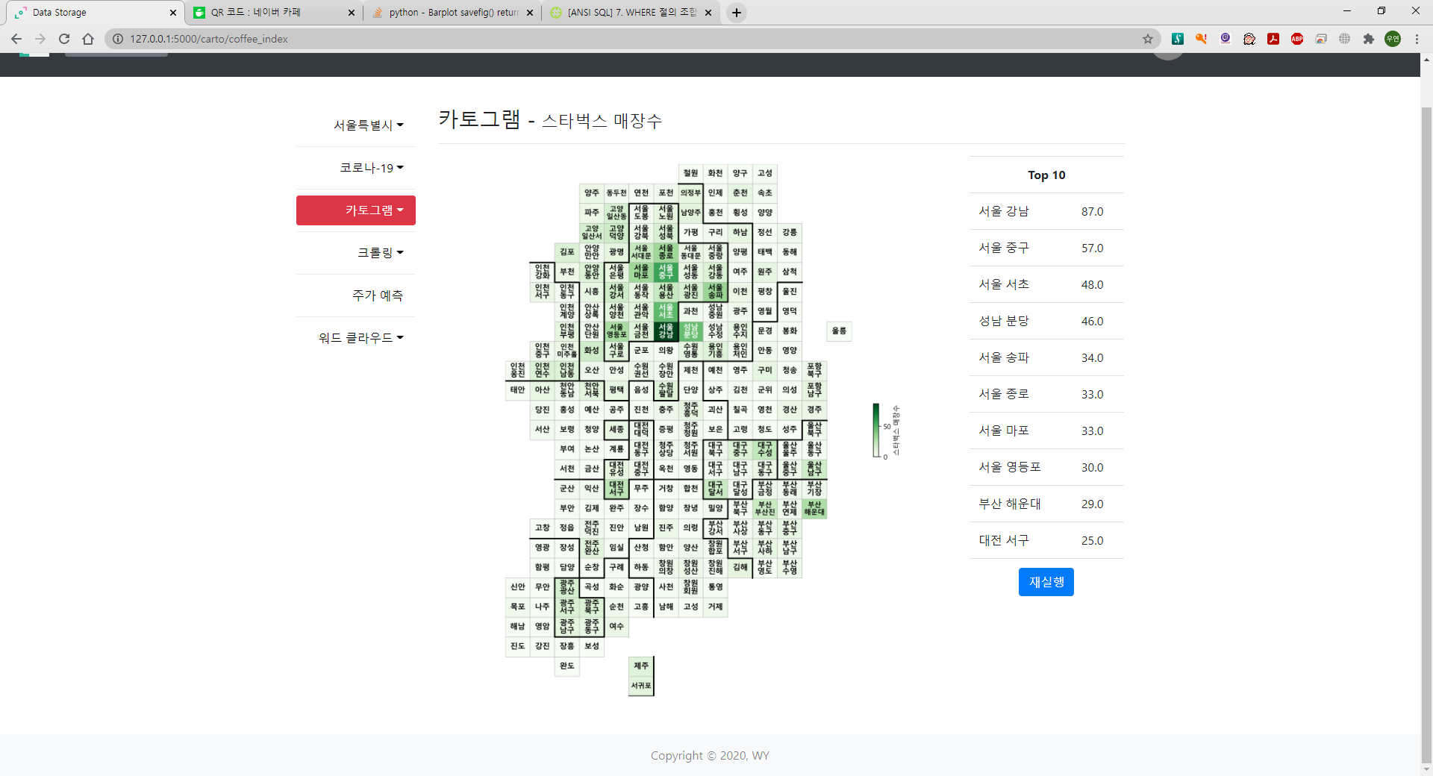

Slide 50
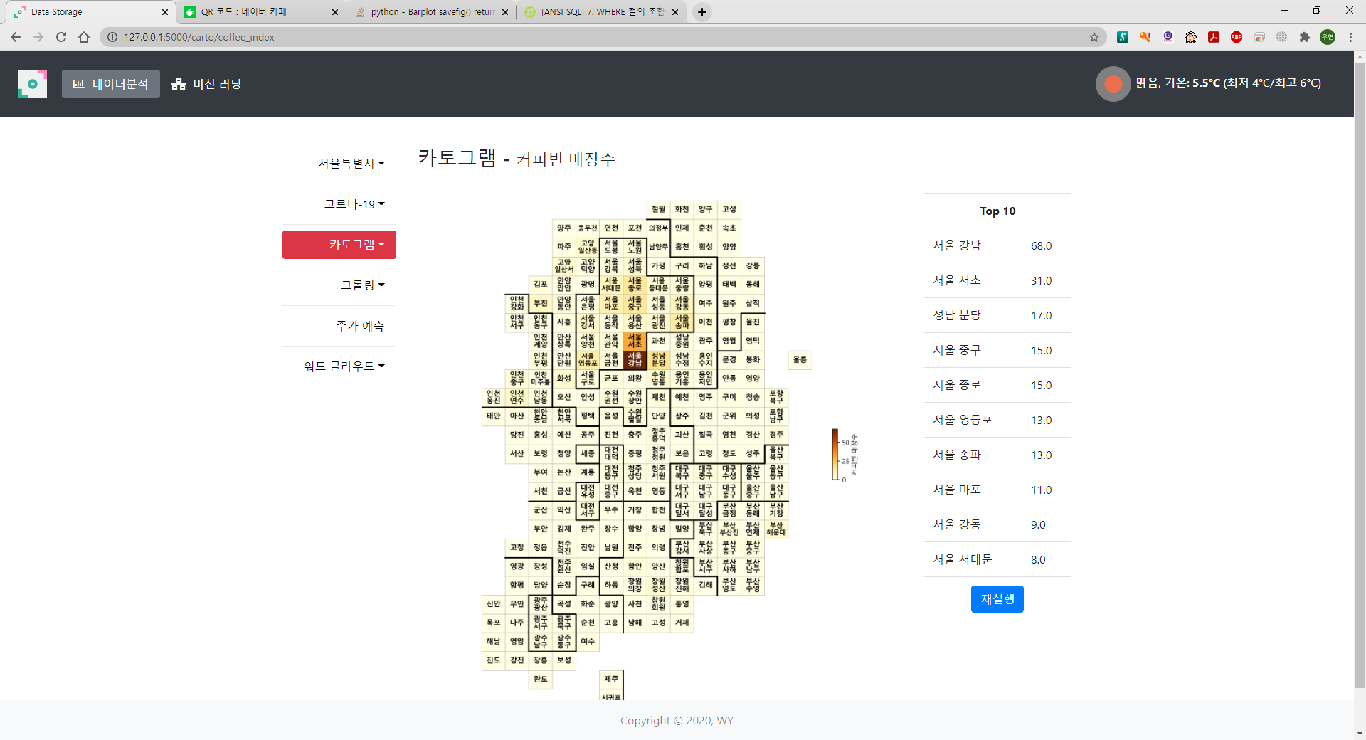

Slide 51
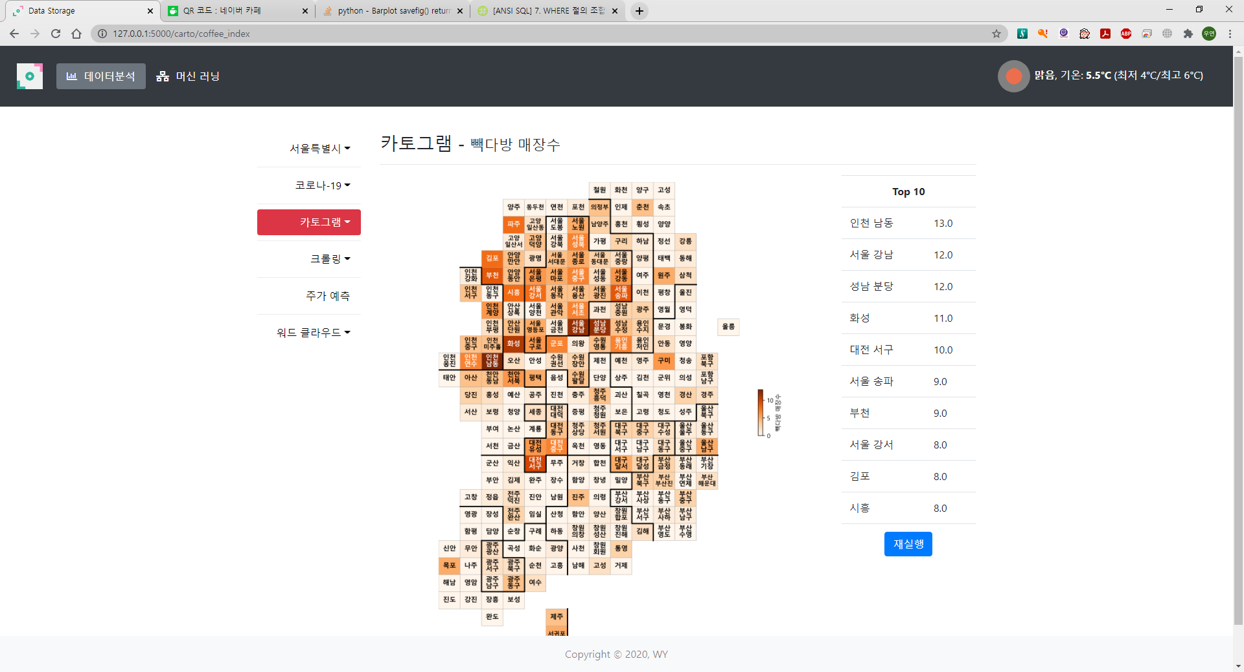

Slide 52
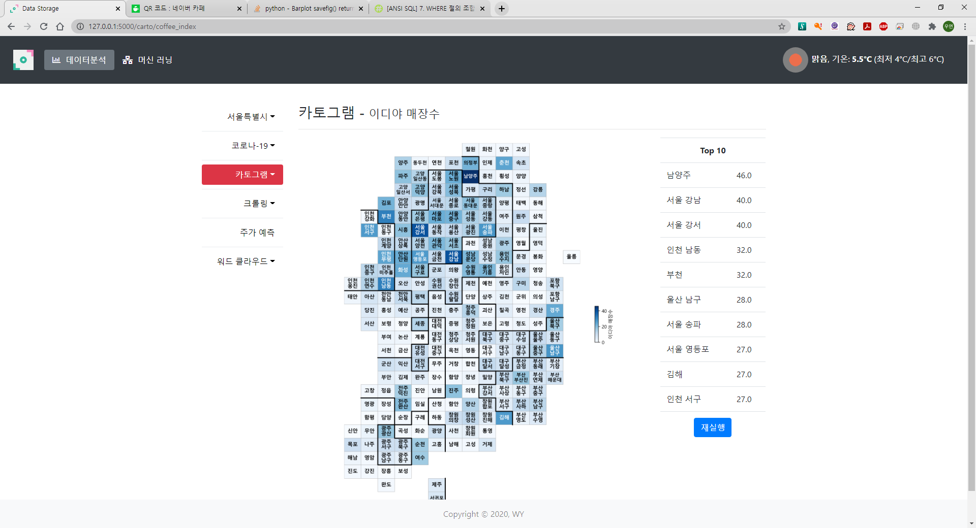

Slide 53
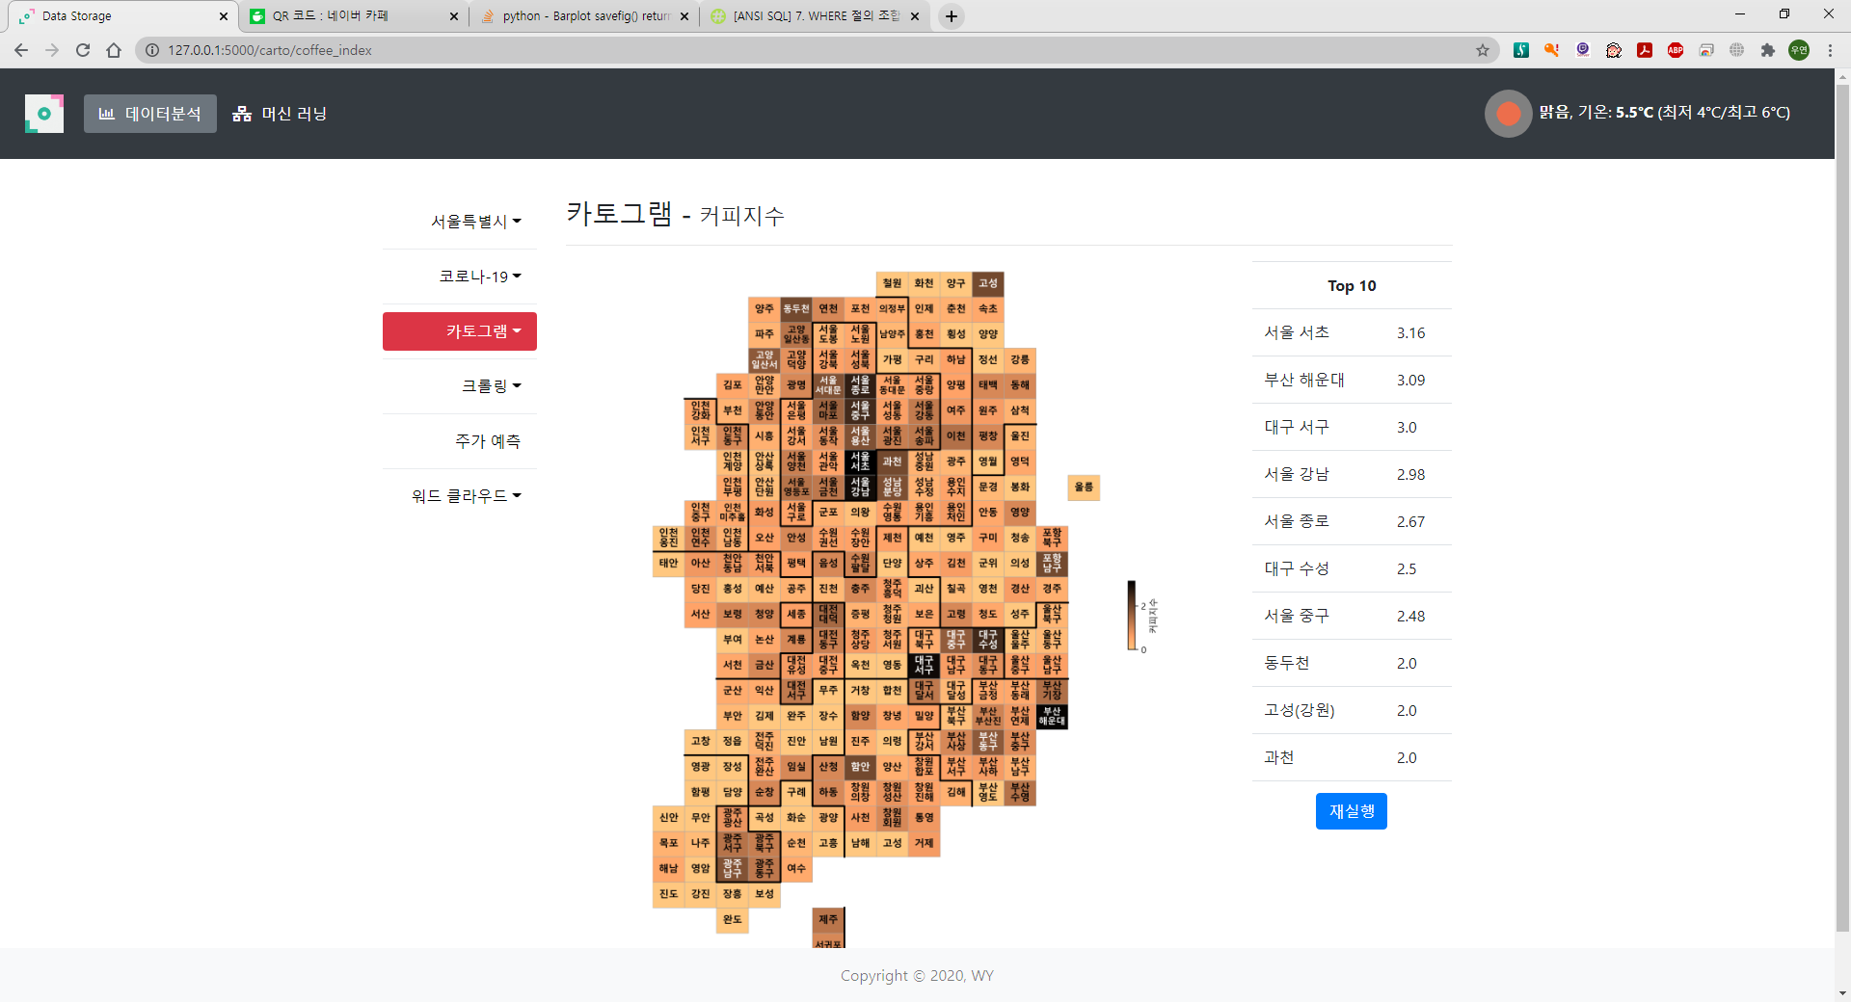

Slide 54
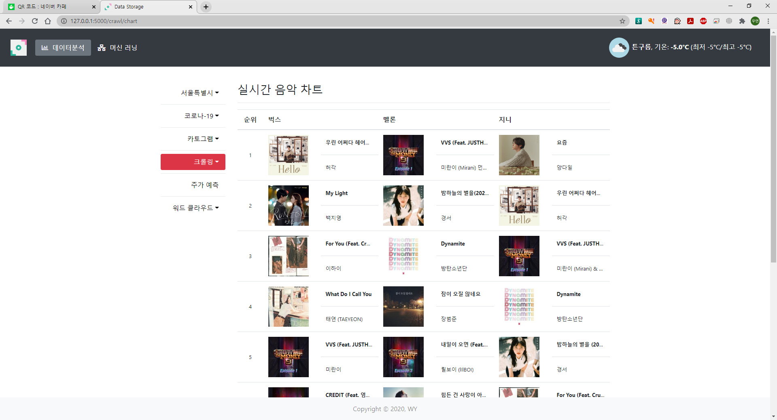
벅스, 멜론, 지니 실시간 차트

Slide 55
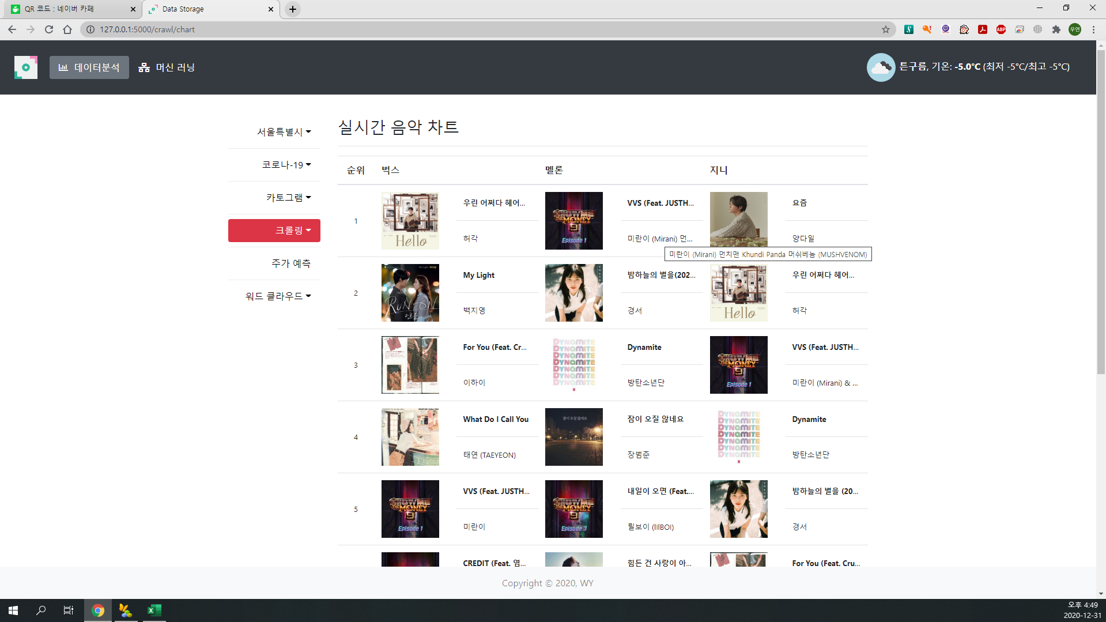
마우스 오버
툴팁

Slide 56
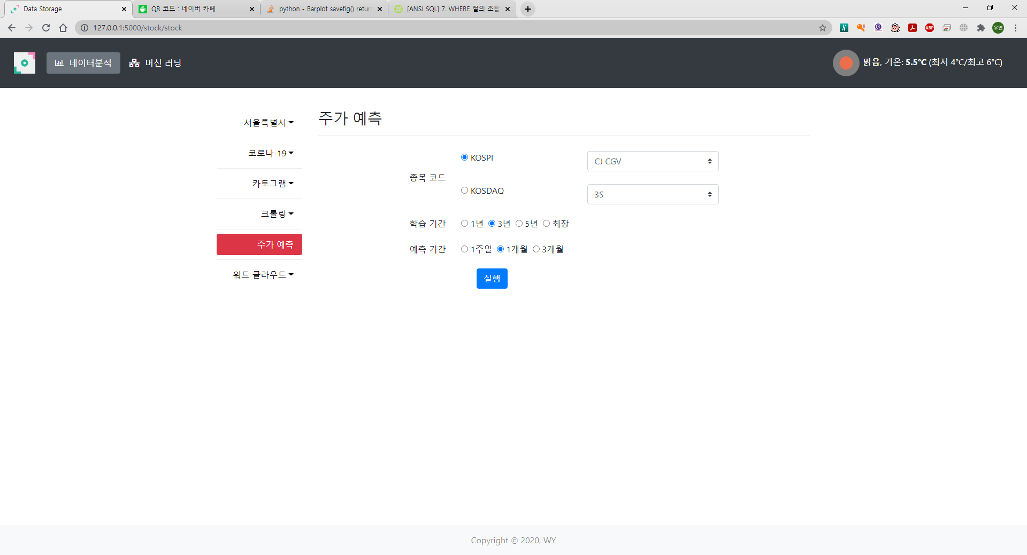

Slide 57
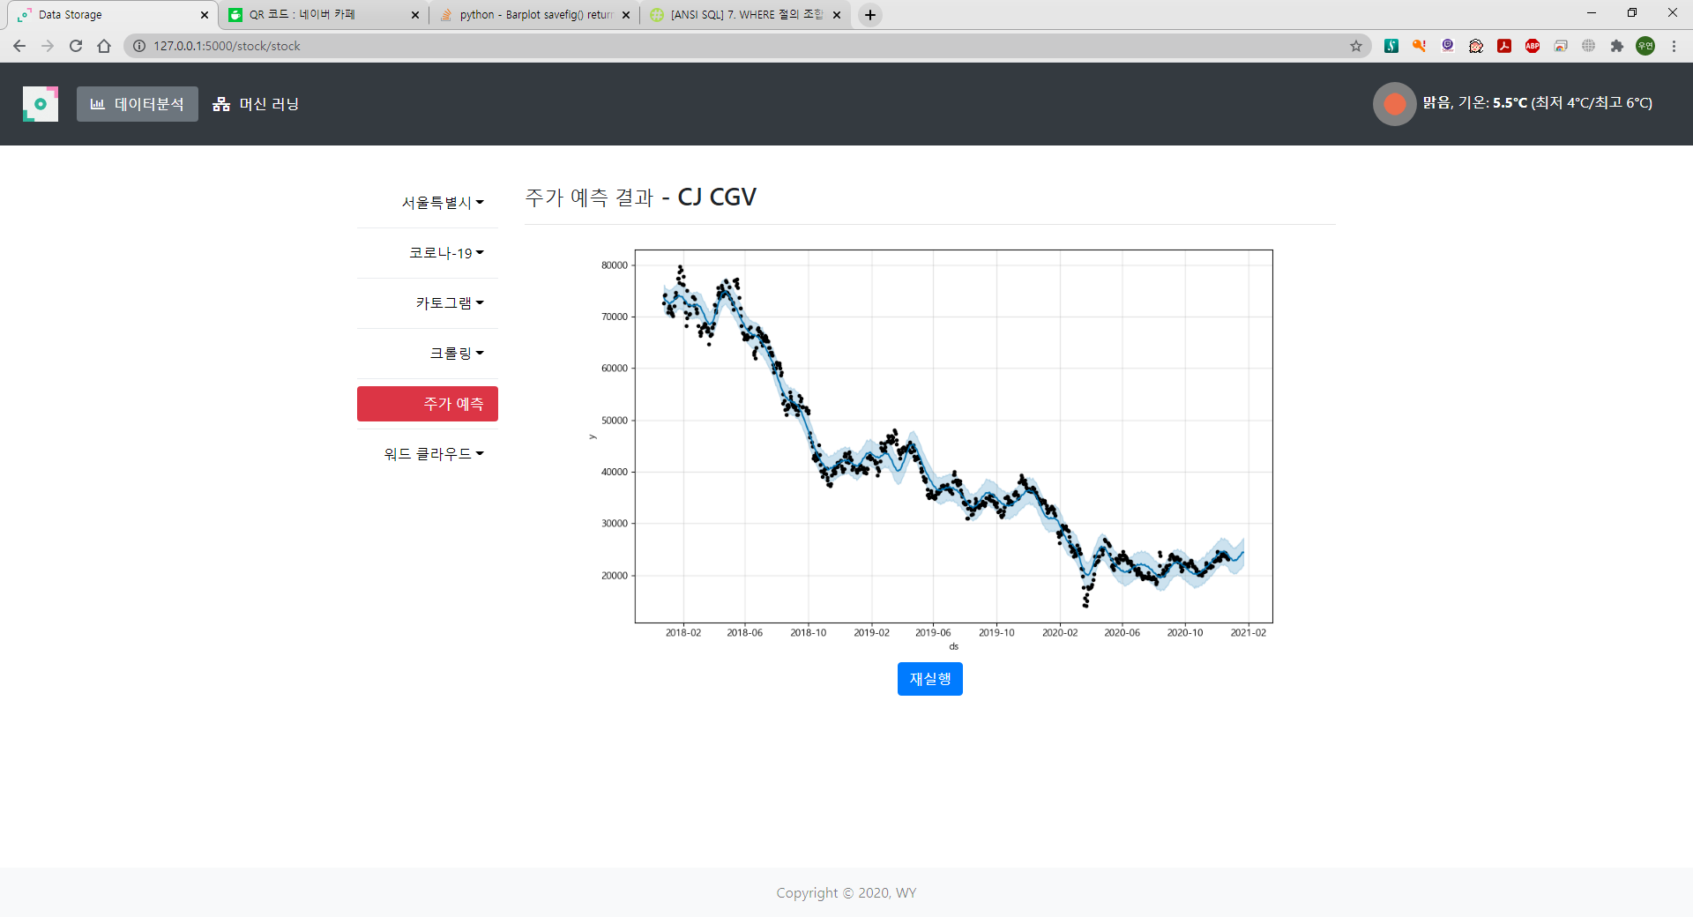

Slide 58


Slide 59
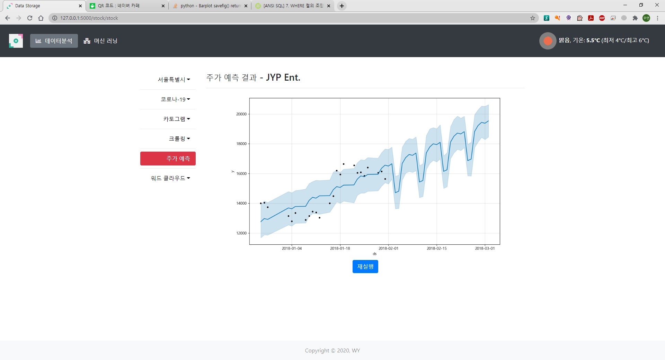

Slide 60
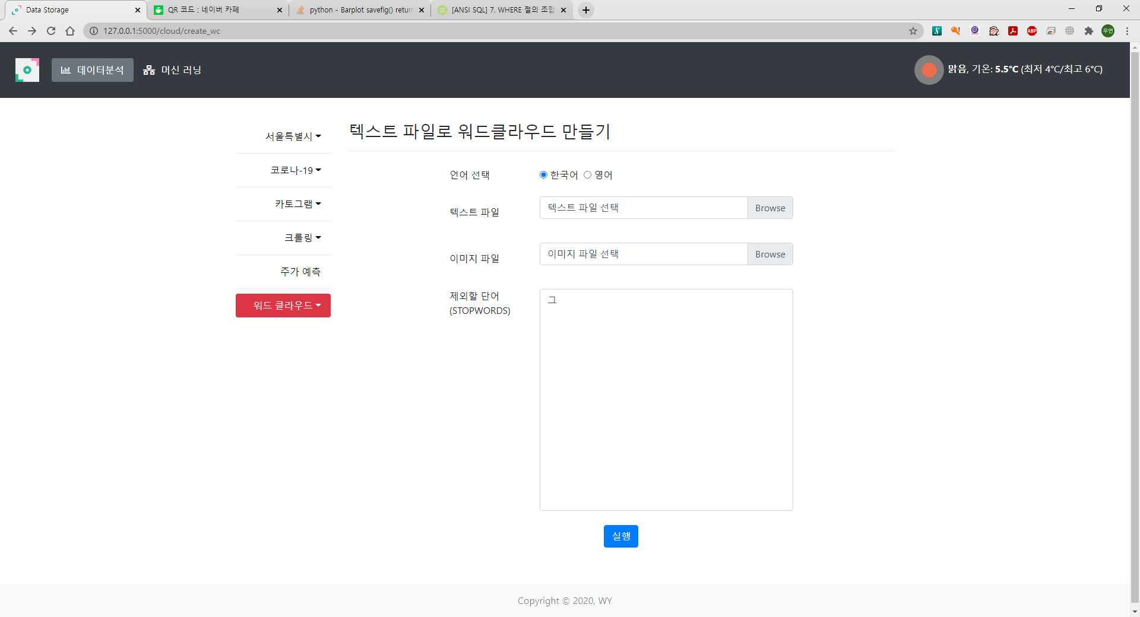

Slide 61
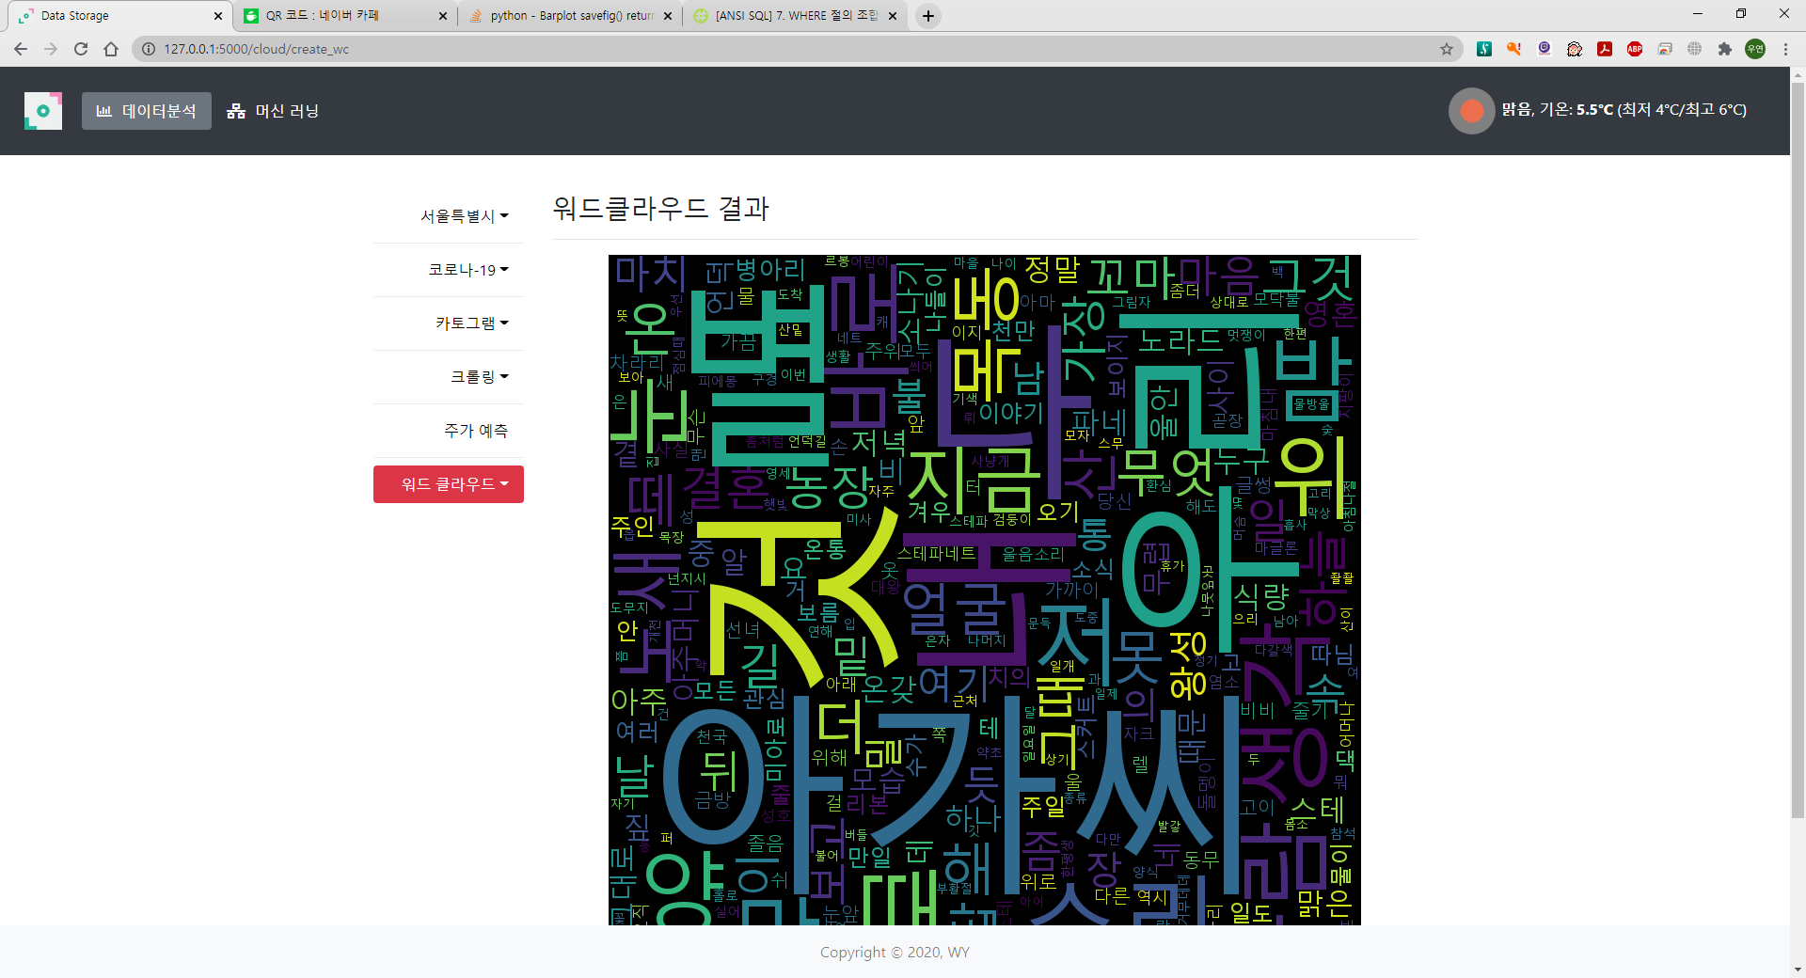

Slide 62


Slide 63
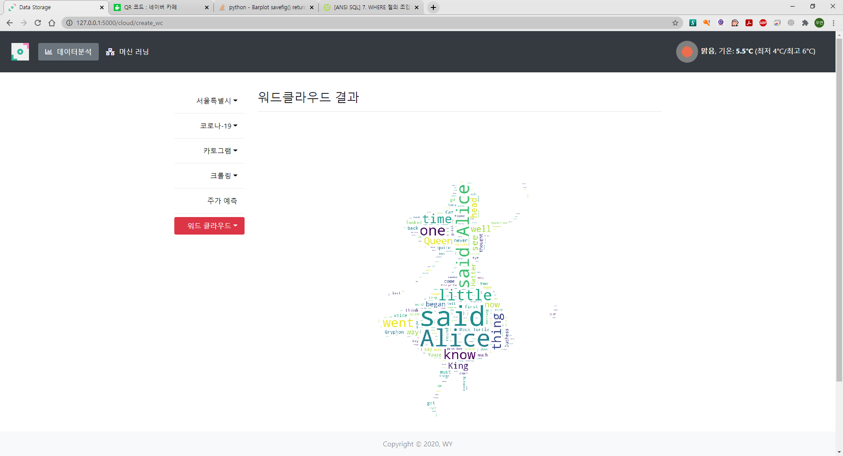

Slide 64
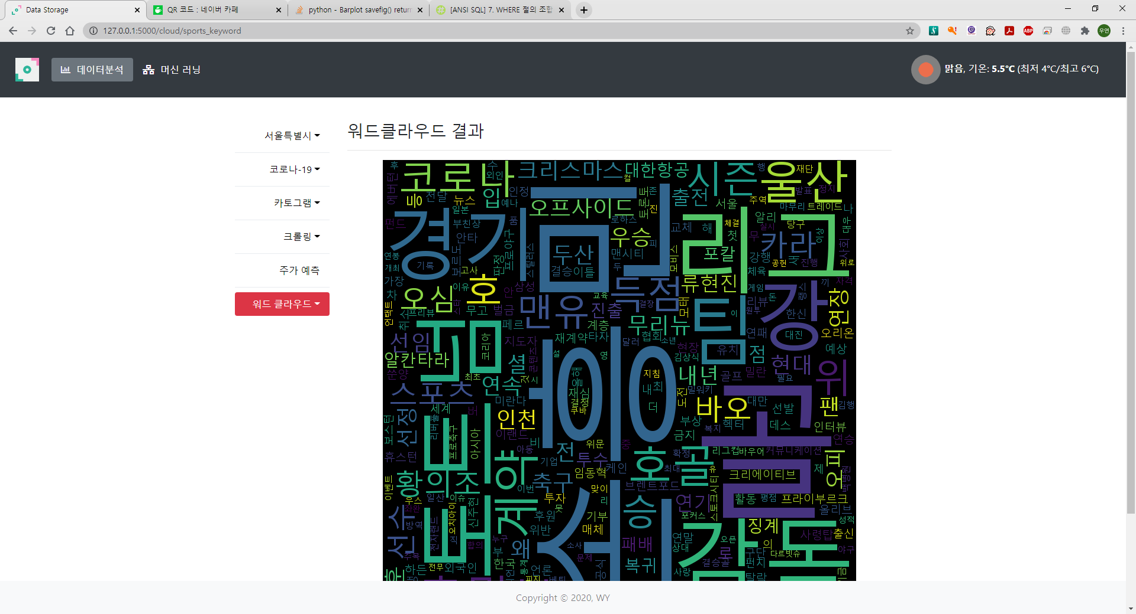
스포츠 뉴스 크롤링 후 워드클라우드

Slide 65
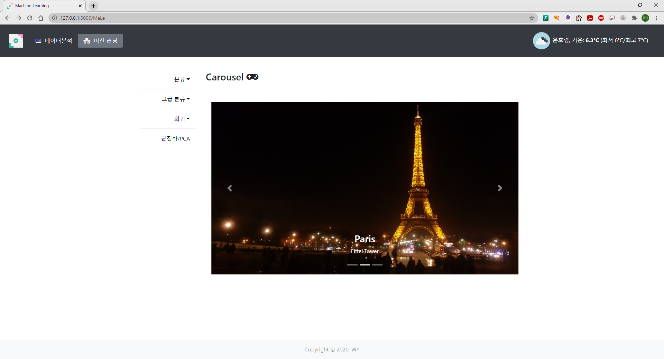
MaLe 화면

Slide 66

cancer.html

Slide 67

cancer_res.html

Slide 68

pima.html

Slide 69

pima_res.html

Slide 70

titanic.html

Slide 71

titanic_res.html

Slide 72

iris.html

Slide 73

iris_res.html

Slide 74

wine.html

Slide 75

wine_res.html

Slide 76

20news.html

Slide 77

20news_res.html

Slide 78

IMDB.html

Slide 79

IMDB_res.html
테스트 데이터

Slide 80

IMDB_res.html
리뷰 텍스트 입력

Slide 81

mnist.html

Slide 82

mnist_res.html

Slide 83

naver.html

Slide 84

naver_res.html
테스트 데이터

Slide 85

naver_res.html
리뷰 입력

Slide 86

iris.html

Slide 87

iris_res.html

Slide 88

diabetes.html

Slide 89

diabetes_res.html

Slide 90

boston.html

Slide 91

boston_res.html

Slide 92

clust.html

Slide 93

clust_res.html

Slide 94

trans.html

Slide 95

trans_res.html
영어

Slide 96

trans_res.html
일본어

Slide 97

trans_res.html
중국어

Slide 98

trans_res.html
프랑스어

Slide 99

tts.html

Slide 100

tts_res.html

Slide 101

trncls.html

Slide 102

trncls_res.html
한 → 영

Slide 103

trncls_res.html
영 → 한

Slide 104

detect.html

Slide 105

detect_res.html
영어 감지

Slide 106

detect_res.html
일본어 감지

